Slide 1
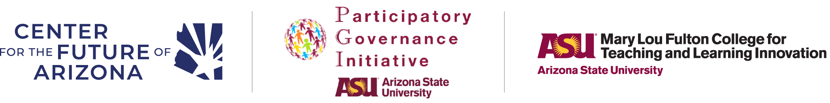
School Participatory Budgeting
An innovative civic learning model
[Insert Date and Name]
Notes:
Hello! This is the master file for the School Participatory Budgeting (SPB) presentation! This will be your go-to guide on how to construct and deliver a presentation to faculty and staff at your school/district. Each slide will include instructions in the slide notes on the necessary changes to modify these slides, so you can create the best possible presentation to effectively advocate for SPB at your school. If you need additional help, please contact civichealth@arizonafuture.org.
Introduce yourself and potentially share what motivated you to introduce School Participatory Budgeting (SPB) to your audience.
School Participatory Budgeting (or SPB) contributes to CFA's mission by preparing young people to be active, informed, and engaged participants in civic life for the long-term.
This innovative civic learning process is a student-driven process that empowers real decision-making power over how to spend real dollars on school improvement projects. Today we will share with you why SPB is so impactful, how it works, and how you can become involved in bringing this initiative to our school.

Slide 2
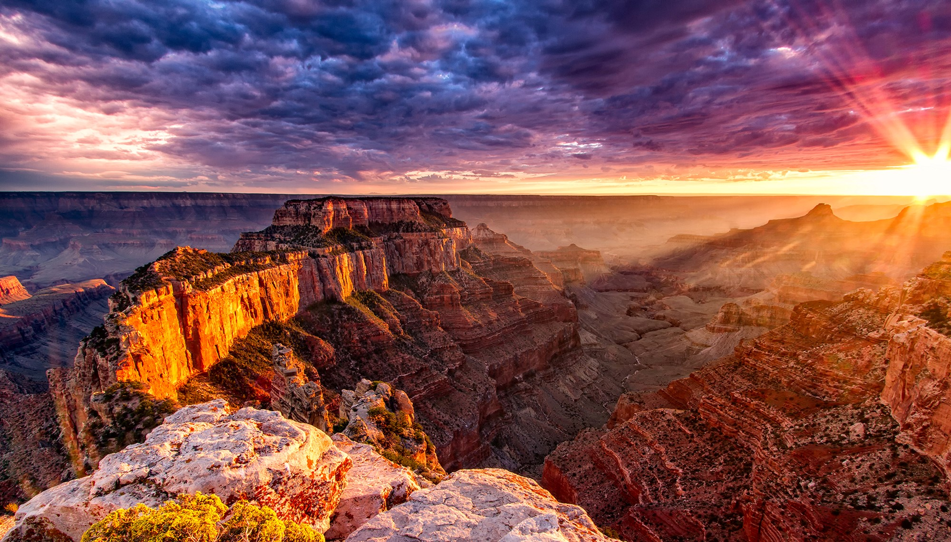

Mission
The Center for the Future of Arizona brings Arizonans together to build a stronger and brighter future for our state.
Notes:
This slide provides the mission of the Center for the Future of Arizona (CFA) to establish context as to what CFA is and why the organization supports the implementation of SPB at schools and districts across Arizona.
Center for the Future of Arizona (CFA) is a nonpartisan, nonprofit organization with a mission to build a stronger and brighter future for our state. Through deep programmatic work in education, workforce, and civic health, CFA collaborates with Arizona leaders to work to realize The Arizona We Want, a shared vision for the future of our state.
CFA does their work in three key ways:
Listen to Arizonans about what matters to them regarding our state’s future
Share trusted information and data on how we are doing as a state on those critical issues
Partner with communities and leaders throughout Arizona to support their goals and priorities for the future
Our civic health, how we come together to define and address public problems, is critical to long-term individual and community well-being. Communities with robust civic health have higher employment rates, stronger schools, better physical health, and more responsive governments. CFA is committed to improving Arizona's civic health by strengthening civic engagement and empowering Arizonans to shape their communities and the future of the state.

Slide 3

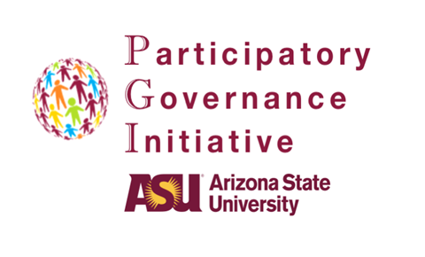
Arizona State University’s (ASU) Mary Lou Fulton College for Teaching and Learning Innovation
& the Participatory Governance Initiative serve as thought partners, offering training and support to schools implementing SPB, and leading evaluation activities.
Notes:
FA and ASU.
Additional information about the partnership between CFA and Arizona State University (ASU). Especially helpful to highlight if your school/district is interested in seeing evidence of impact from initiatives and programs and may want to partner to conduct evaluations.
CFA works in close partnership with Arizona State University, as thought partners and leaders in the participatory governance and civic education spaces. ASU also leads the research and evaluation activities to better understand the impact of PB.

Slide 4
What is PB?
Participatory Budgeting (PB) is a democratic process in which community members directly decide how to spend a portion of a public budget.
1989
PB Process Originated at the municipal level in Porto Alegre, Brazil
2013
Bioscience High School in Phoenix Union (PXU) adapts the municipal PB model into schools, pioneering the first School PB (SPB) process in North America
2016
CFA & ASU train alongside Participatory Budgeting Project and PXU to learn how to scale within school setting
SPB in Arizona has been implemented in over 100 schools across 20 districts impacting thousands of Arizonan students
2026
Notes:
This slide provides a historical overview of Participatory Budgeting and shows that it has had success globally, with particular emphasis on Arizona. This gives an easy-to-visualize story as to how SPB has evolved since 1989.and gives credibility to t SPB as it has been implemented in many different settings.
Participatory budgeting is a democratic process in which community members decide how to spend a portion of a public budget. It began at the municipal level in Brazil in 1989 and spread to thousands of processes across the globe. In 2013, Arizona adapted the municipal process into schools, becoming a pioneer for the School Participatory Budgeting process in North America. CFA & ASU became the regional technical assistance advisors and continue to champion the process across Arizona, nation, and world. As of 2026, SPB has been implemented in over 100 schools across 20 districts, impacting thousands of students.

Slide 5
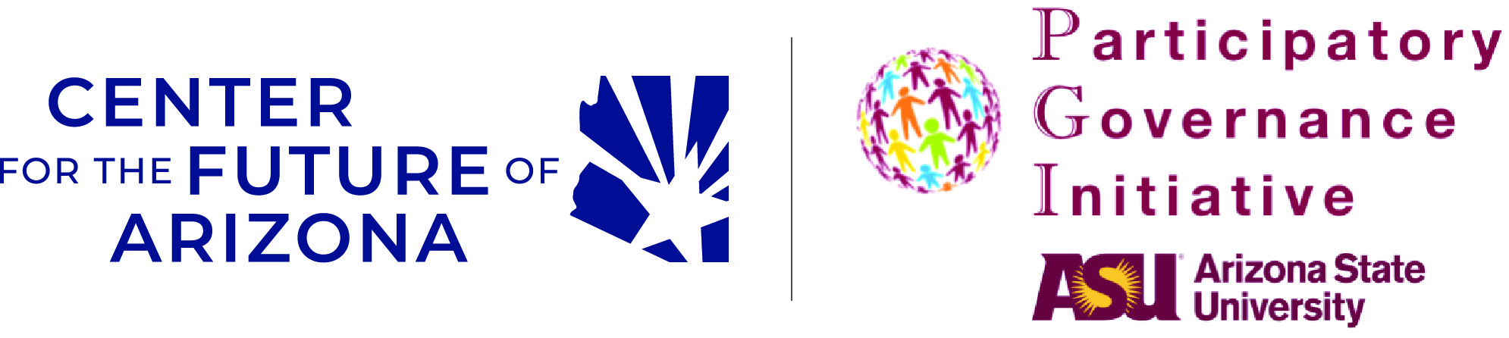


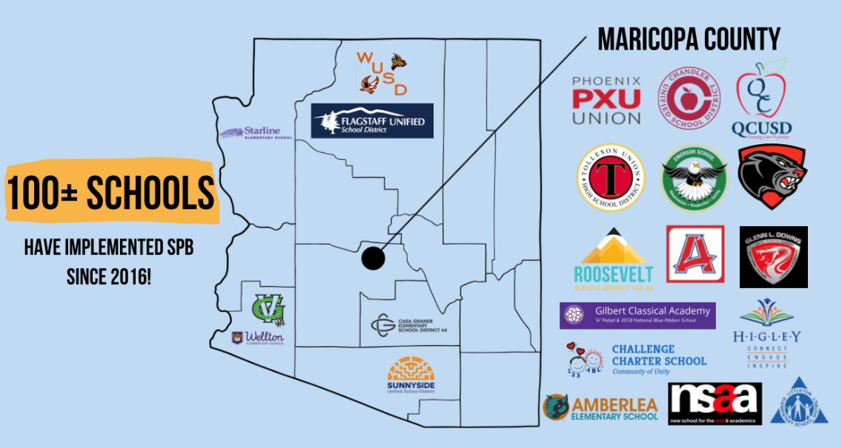
Growth of SPB in AZ
Growth of SPB in AZ
In 2026, SPB has been implemented in 100 schools since 2016.
By 2030, we hope to see SPB impacting a third of Arizonan students, roughly 300,000 across 150 schools!
Notes:
This slide provides a localized view of where SPB has been implemented across Arizona. When presenting, consider identifying a neighboring school/district in your area to give a sense of familiarity with the SPB initiative. Consider moving this slide toward the end to help convince administrators who might still be hesitant.
Some examples of schools that have implemented the process can be seen here, illustrating that the SPB process can adapt to different communities and contexts. We could continue to contribute to this growth and impact by joining the initiative!

Slide 6

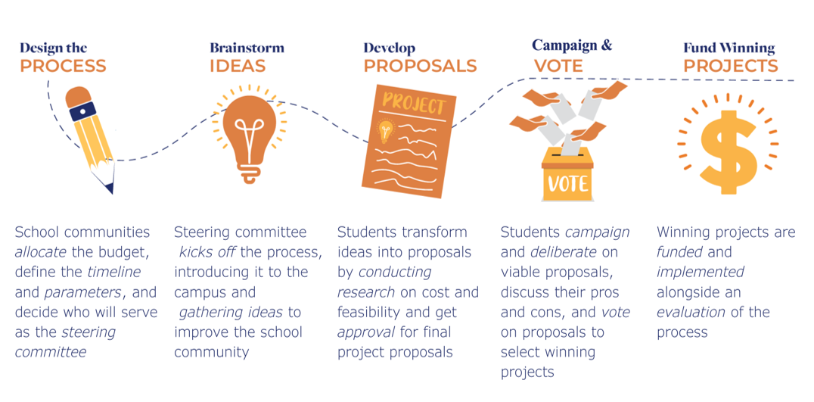
How SPB Works
Notes:
VERY IMPORTANT SLIDE. Up until now, the presentation has provided a background for School PB. This slide walks through how SPB works in practice and gives an outline of the five phases of the process.
School Participatory Budgeting is a process where students can "learn democracy by doing" by directly deciding how to spend a portion of their school or district dollars.
Process is highly adaptable and can be designed for your school community, by your school community
Integral to the process is securing a budget and empowering student leadership; a group of students form a steering committee that support these 5 key phases:
Students collect ideas to improve the school community.
Students transform ideas into proposals by conducting research on cost and feasibility.
Students deliberate on viable proposals and discuss their pros and cons.
Students vote to select winning projects.
Winning projects are funded and implemented.
The process lends to the project-based and experiential learning aspects that illustrate that SPB is unlike other civic education programs that might be more simulation-based. Because the students see real change through their contributions, we hope the process has a transformative impact on how they contribute to their community in the long-run.
One demonstration of that is on Vote Days, especially in high schools. After casting their SPB ballot, some schools might partner with their local county recorder offices or community organizations to conduct voter registration for eligible and interested high school students to be prepared to participate in their upcoming local, state, and federal elections. Since 2016, over 9,000 students have been registered to vote during an SPB vote day.
CFA & ASU have been able to capture early evidence of the impact on students, school climate and culture through process and impact evaluations.

Slide 7
SPB in Arizona:
Stakeholder Perspectives Today
SPB in Arizona Today: Stakeholder Perspectives
[Insert video specific to your audience]
Notes:
In the slide notes is a list of videos from different school stakeholders. Please select the video that best aligns who to your audience. Depending on the amount of time you have, you may consider sending the video before or after the presentation. Be sure to check the length of the video you want to share to ensure that it will fit within your timeframe.
Please feel free to add video testimonials based on your audience. Options can be added from below:
Learning Democracy by Doing: School Participatory Budgeting in Arizona https://vimeo.com/1067458515
Student Voices: The Impact of School Participatory Budgeting https://vimeo.com/1067458283
How School Participatory Budgeting Empowers Future Voters https://vimeo.com/1067458405
Administrator Perspective: How School Participatory Budgeting Impacts Students https://vimeo.com/1075369063
District Leader Testimonial: Systemwide Impact of School PB https://vimeo.com/1075428458
Teacher Perspective: How School Participatory Budgeting Impacts Students https://vimeo.com/1075430004
Teacher Testimonial: How School PB Empowers Student Leadership https://vimeo.com/1075369892
Teacher Testimonial: How School PB Supports Student Growth https://vimeo.com/1075429328
Principal Testimonial: School Culture Changes Through School PB https://vimeo.com/1075371823

Slide 8
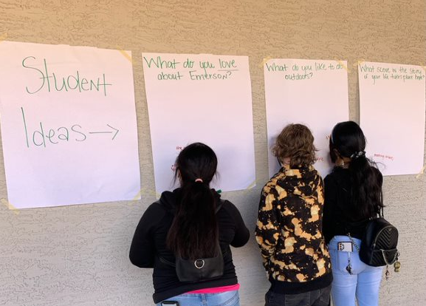
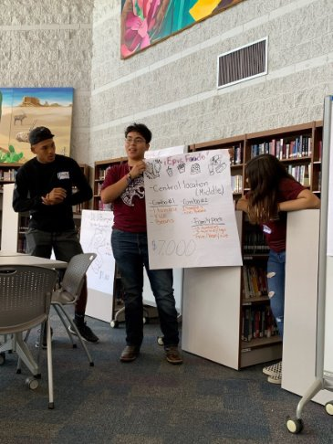
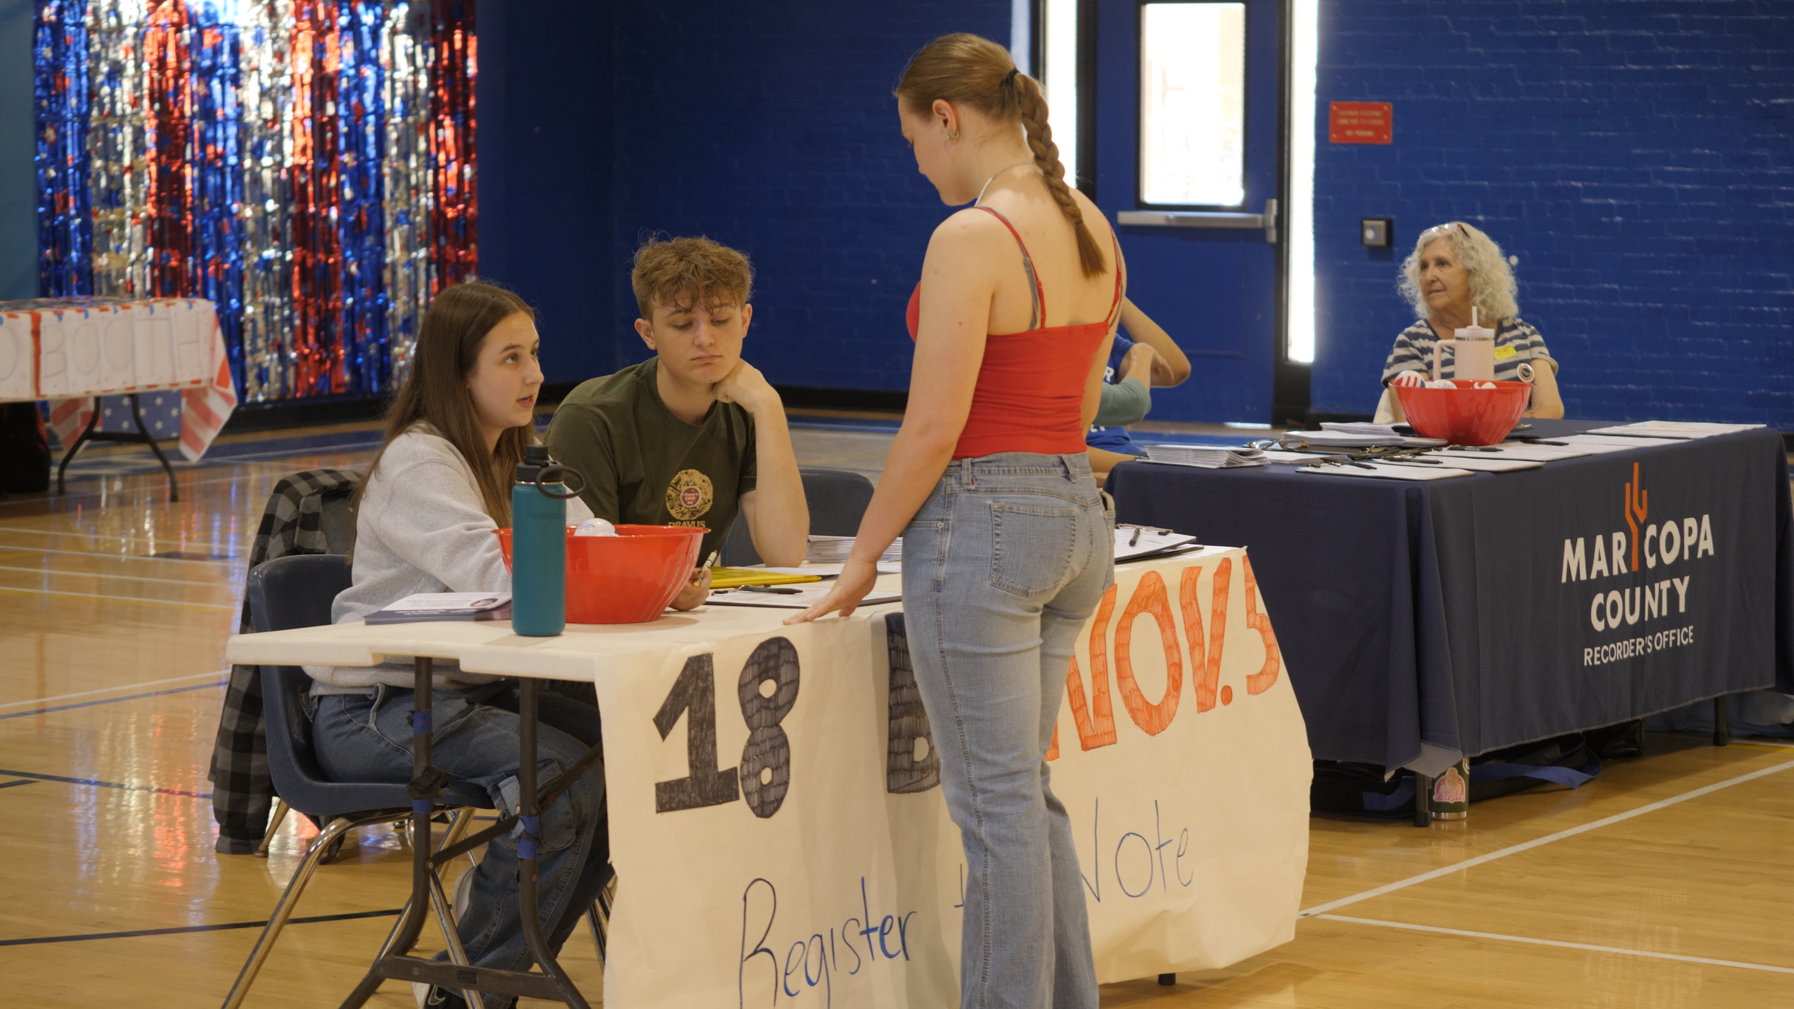
Why School Participatory Budgeting?
“The initiative is helping us to create an environment that nurtures leadership in our students, promotes civic engagement, and builds community throughout every school within our district.”
Superintendent, 2017
Contextualize why SPB would be good in your school/district specifically
Notes:
This is another very important slide. In the notes section, there are examples of general talking and bullet points that could be included in the slide. However, it is key to contextualize why SPB would be beneficial in your specific school environment. For example, if your school has specific goals it wants a student to reach (an example being Kyrene's Portrait of a Kyrene Kid at Graduation), contextualize it to that and how it builds on the themes and mission of your school/district.
Generic examples:
Outside of the long-term vision of building the next generation of civic and community-minded leaders; you may wonder Why SPB is relevant for your school community?
Empower students: SPB empowers students, one of the most important stakeholders in the school community, to be active decision makers.
Project Based & Experiential Learning: Students who participate in this high impact learning opportunity experience a deeper understanding of decision-making processes in their school and the democratic process for their community. SPB can be designed in ways that facilitate project-based and experiential learning with current initiatives, classroom learning, or extracurricular activities.
Student Ownership in School Community: Through empowering students, they can become more engaged and take pride in their school; especially when they see the outcomes of their contribution to school improvement projects.
Foster Sense of Responsibility and Belonging: Alongside this ownership in the internalized sense of responsibility and belonging.
Build Essential Civic Competencies and Skills: Students learn how to listen to empathize with others, collaborate across differences, and think critically about the sustainability and impact of their project on the students in their school.
Civic Opportunity Gap: With intentional design, SPB can provide an opportunity for students who are not usually exposed to these types of civic learning opportunities to participate, ultimately leading toward closing the civic opportunity gap for students.

Slide 9
At-a-Glance Findings on Student Agency and School Climate
When surveyed, student steering committee members reported they
know more about participating in a democracy, including how public budgets and the decision-making processes at their schools work
feel that they can make a difference in their school community because they feel more heard and connected
are better equipped with skills like being able to speak in front of others, analyze information, and work collaboratively in a group setting that translate to the classroom setting to the workplace and society
plan to solve other problems within their school community, keep their school clean, and vote as soon as they are able
Notes:
This slide is very important as it provides evidence-based benefits as to why School PB is great for students. The slide notes include citations from peer-reviewed studies as references to show how the benefits are tangible, with findings based on survey data from students who participated in School PB processes.
Some of the preliminary outcomes related to student civic capacities are gleaned from the internationally-used KASP survey:
The KASP survey, which stands for Knowledge, Attitudes, Skills, and Practices, contains subsets of indicators for each area that measure changes in the participants who have served on the student steering committee during the SPB process. These questions are designed as pre- and post-reflections and are measured on a 1-5 Likert scale of Strongly Agree to Strongly Disagree. Each subset (Knowledge, Attitudes, Skills, and Practices) of indicators is followed by an open-ended question prompting participants to add any other context or changes aligned with that particular subset.
Knowledge: know more about participating in a democracy, public budgets, decision-making processes in their school
Attitudes: feel like they can make a difference, are more heard and connected to other students and adults on campus
Skills: better able to speak in front of others, analyze information, and work together
Practices: help solve other problems, keep their school clean, and vote as soon as they are able
Additional research on civic learning outcomes found students to have increased knowledge of the history and tenets of democracy and public budgets, heightened skills in project management, research, and leadership, improved deliberative and decision-making competencies, and strengthened political efficacy (Abrantes et al., 2017; Bartlett & Schugurensky, 2023; Brennan, 2016; Cohen et al., 2015; Crum & Faydash, 2018; Duncikaite, 2019; Gibbs et al., 2021; Johnson, 2023; Todd, 2022). The effects on school climate have been observed in increased levels of trust, peaceful resolution of conflicts, demonstrations of empathy and a common good mindset, and stronger relationships between members of the school community (Albornoz-Manyoma et al., 2020; Brown, 2018; Kupriyanov, 2023). School improvements stemming from an SPB process include changes in educators’ perceptions of young people, heightened leadership competencies among teachers, and tangible improvements to a school’s campus (Bartlett et al., 2020; Cheerakathil, 2023; Parrish, 2023).

Slide 10
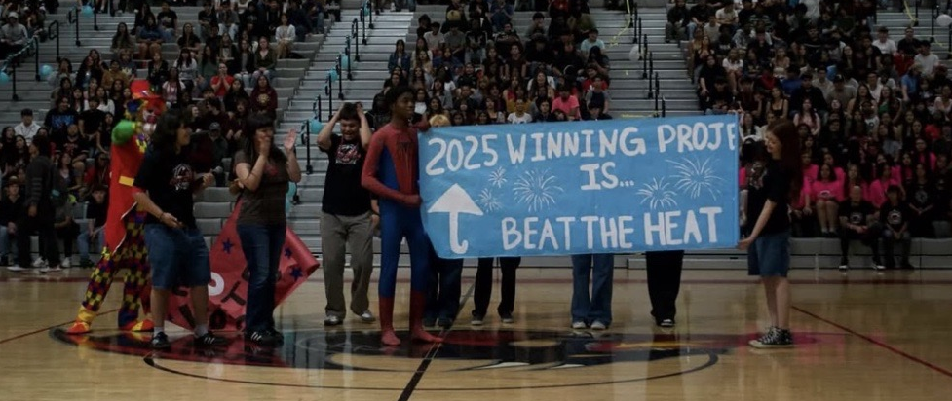
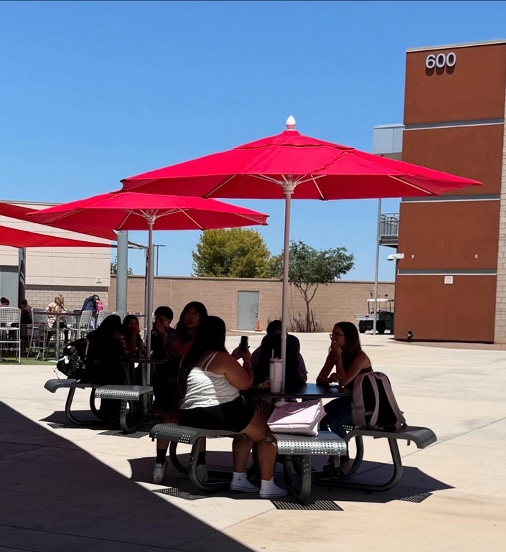
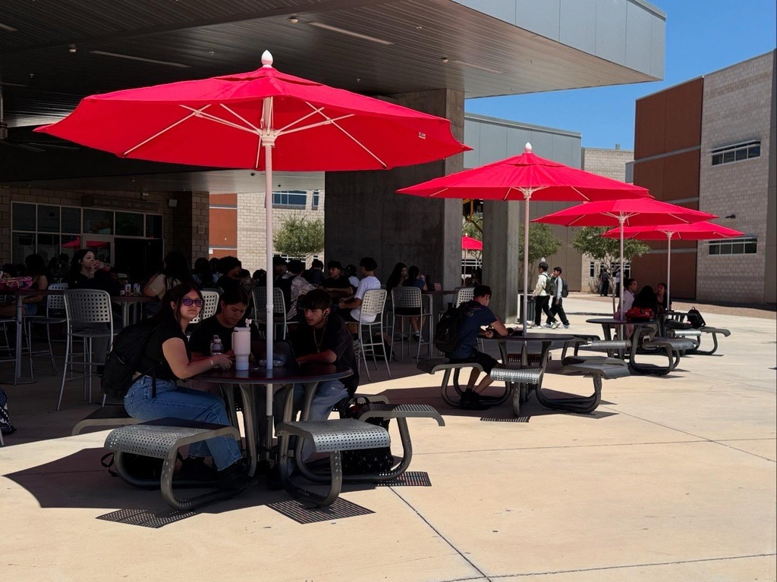
Case Study: WPHS
​Budget: $600-$12,000
Funding Sources: Principal Funds​ and Site Council Funds
Setting: Civic Action Club
Winning Project: Beat the Heat The project funds the installation of umbrellas in the cafeteria tables. The tables will be moved out of the shaded structure to the quad to provide more space for students to be in that is shaded.
Notes:
This section provides a curated list of case studies that can be used to demonstrate how SPB can be implemented in your school. You should choose one example or two at max so as not to be redundant. It is key to pick specific examples that are the most contextual to your school. The rest of the examples can be hidden or deleted for clarity.
The West Point High School example can be used to demonstrate SPB implementation at the high school level led by a teacher champion.
The West Point High School example can be used to demonstrate SPB implementation at the high school level.

Slide 11
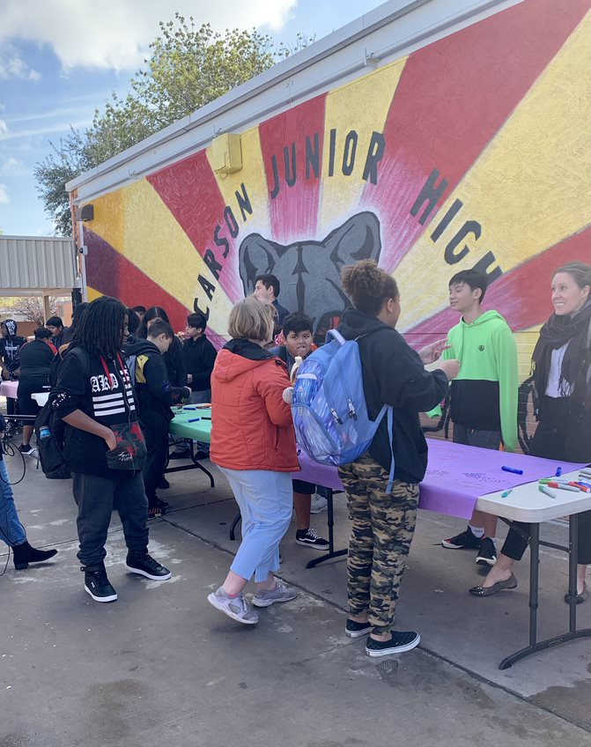
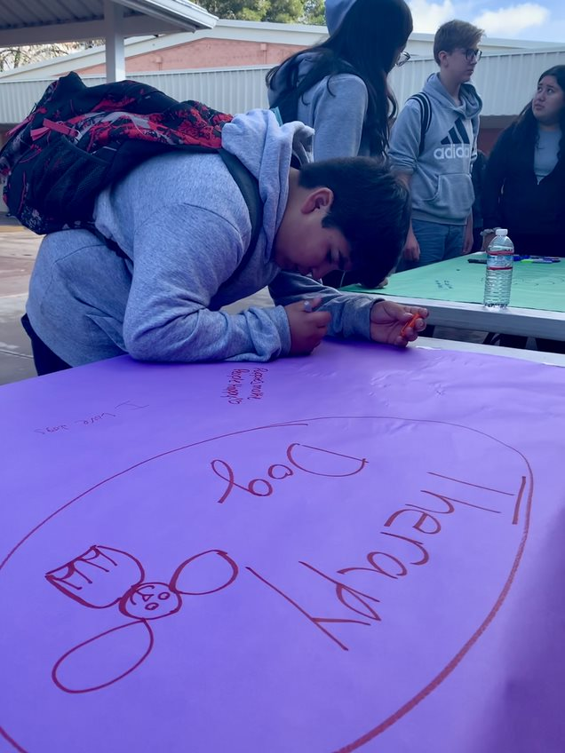
Case Study: Inclusive SPB
Budget: $1,500 - 2,000
Funding Sources: Student Council Funds, Principal Discretionary Funds, District Foundation Grant
Setting: One School with Classroom & New Extracurricular Models
Key Stakeholders:
  Sponsors: Teacher support model
  Student Steering Committee: 31 7th-8th Grade Students (1/3+ Students with Disabilities) Families Involved
Winning Project: Water Bottle Refill Stations, School Spirit Mural, School Therapy Dog, Scooter & Skateboard Transportation
Notes:
This slide can be used when you are trying to implement SPB with a specific focus and build inclusion on your campus.
This inclusive SPB model was a collaborative community approach to ensuring that the SPB process could be inclusive to ALL students. With the support from the Arizona Developmental Disabilities Planning Counci, Carson Junior High in Mesa Public Schools designed their process to have an over-representation of students with disabilities on the steering committee, leading to the Inclusive SPB Toolkit that shares learnings from this experience.
One of the amazing success stories from this example highlights the tangential effects that the SPB process can bring. One year, the winning SPB project was a school therapy dog. The district liked the idea so much that they created a district wide option for all schools to have access to school therapy dogs. Illustrating that SPB can have spillover effects to schools not directly involved with the process.

Slide 12
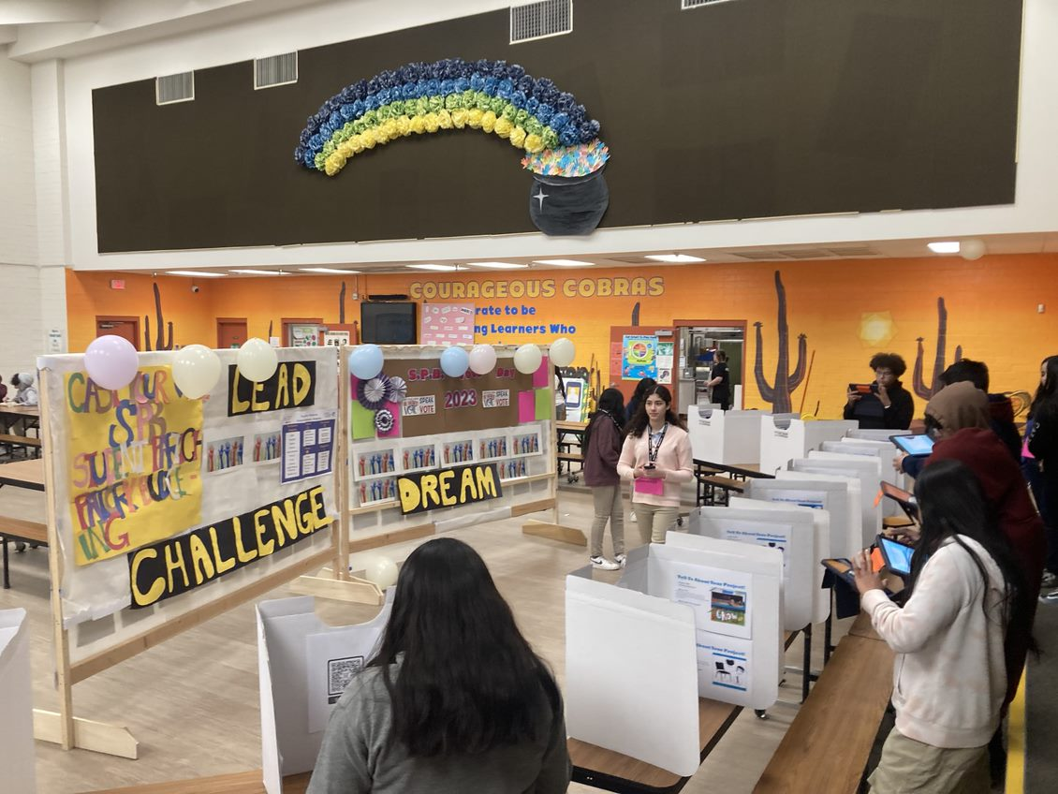
Case Studies: Elementary SPB
Case Study: Elementary SPB
Budget: $2,000 per school
Funding Sources: Desegregated Funds
Setting: 9 Schools Across the District with Classroom, Existing Club, and New Extracurricular Models
Key Stakeholders:
  District Champion & Coordinator: Previous Superintendent, Executive Director of Leadership and Learning & Executive Assistant
  Sponsors: Principals, K-8 Teachers
  Student Steering Committee: K-8 Students in Title 1 Elementary Schools
Winning Projects: Bathroom Mirrors, Recess & Sports Equipment, Game Room, Snack Machines for Field Trips, Seating & Shade
Notes:
This is an example that can be used when the goal is to implement SPB at the elementary school level.
In 2022-23 Roosevelt School District was the first fully-elementary school district to adopt the process and proved that SPB is truly a K-12 civic learning process.
Setting aside a budget for all schools to participate, the district made an open call for any schools interested and willing to participate. About half of the schools opted in to the process and learned that even with a small budget and young kiddos, students can contribute to their school in meaningful ways.

Slide 13
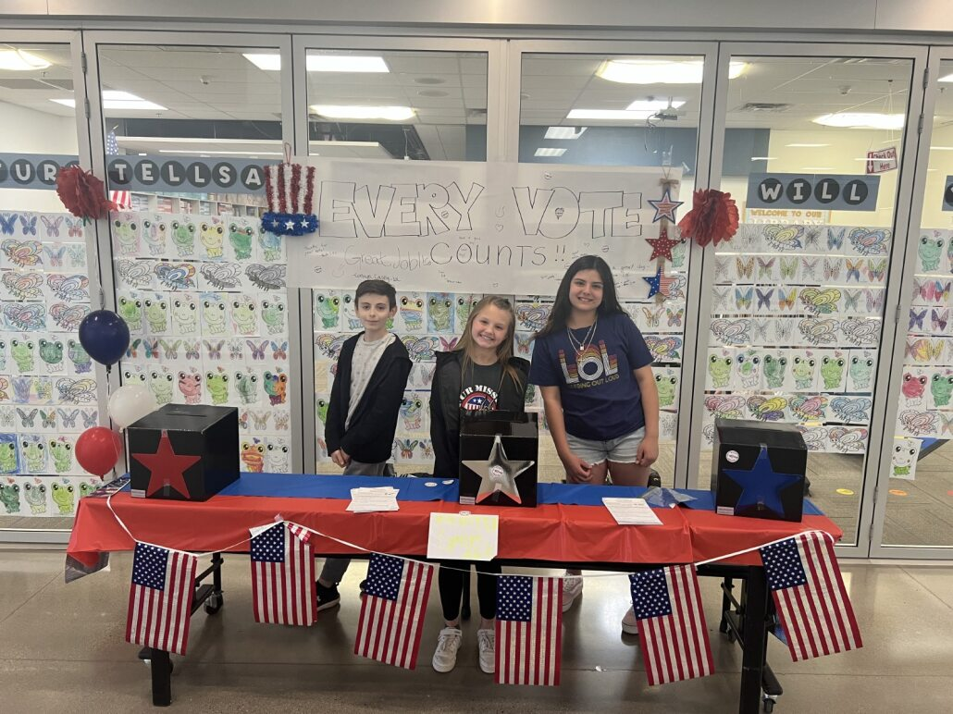
Case Study: District-Wide SPB
Budget: $5,000 - $11,500 per school
Funding Sources: District Budget
Setting: All Schools Participate through Extracurricular or Classroom Setting within Lead Out Loud Club
Key Stakeholders:
  District Champion & Coordinator: Director of Educational Technology & Virtual Learning and Academic Coach
  Sponsors: Teachers across various disciplines
  Student Steering Committee: 4-12th graders
Winning Projects: Book Vending Machine, School Spirit Mural, Recess Equipment, Gaga Pits
Notes:
This slide should be used when your goal is to implement School PB across an entire district.
Queen Creek Unified was also an early adopter to the SPB process and is currently the only district in Arizona with ALL schools implementing SPB.
Designed through the Lead Out Loud program, students who don't always have an opportunity to be in leadership positions are engaged. They even get the chance to present the project proposals to the Governing Board each year, building their public speaking skills and illustrating the power of student voice.

Slide 14
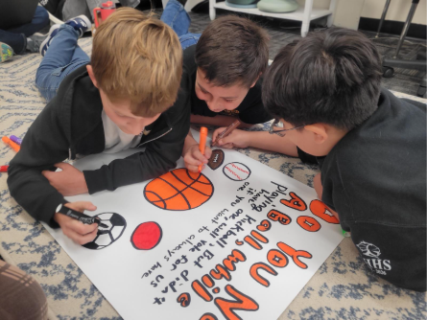
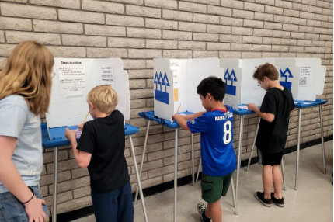
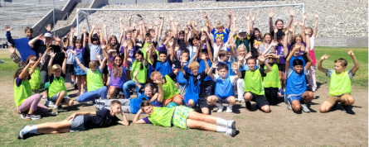
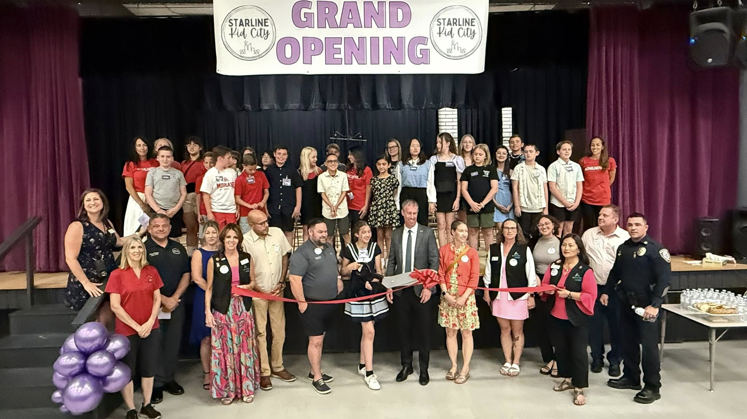
Case Study: Innovative Integrations
​Budget: $4,000
Funding Sources: Local Business/PTO Donations
Setting: Integrated into Kid City civic and economic simulation at a K-6th Elementary School, Steering Committee: 6th Grade Gifted Class
Winning Project: Soccer Nets and Recess Equipment. Students voted for a combined project that included full-sized soccer nets, a new supply of various recess balls and supportive items like jerseys, a storage box, and ball pumps
Notes:
This slide provides an example of how School PB can be integrated into an existing school program to further strengthen outcomes.
In 2024, Starline Elementary School launched the first School Participatory Budgeting (SPB) pilot in Lake Havasu Unified School District (LHUSD). LHUSD partnered with Center for the Future of Arizona (CFA) and Arizona State University (ASU) to pilot, implement, and evaluate the SPB process.
They utilized a $4,000 budget secured by the principal and sponsor by local business and PTO donations. Starline is a K-6th elementary school in which the 6th grade gifted class served as the school's steering committee. They conducting idea collection through each homeroom class, dwindled them down with a primary vote, and integrated their final vote with an already standing event across the campus. Their winning project was Soccer Nets and Recess Equipment that you can see the students enjoying in the images here.
Starline's innovative approach came from the creative way the educators decided to integrate the process into something already happening on their campus. For years, Starline had been leading an experiential civic and economic learning experience where students take on the role of various community stakeholders, including entrepreneurs, bankers, and elected leaders. One student even shared that her mom had done Kids City when she was attending the same school years before.
How does it work? The upper grade bands were responsible for taking on these roles – fourth graders would be the bankers, handing out monopoly money for students to purchase goods and services; fifth graders would create businesses to sell these goods and services; and sixth graders would serve as local leaders, like the mayor, chief police and fire officers, city council and more. This experience allowed them to make connections to career, economics, and civic life with an exciting experience. By integrating the SPB process with Kid City, Starline enhanced the event from a simulation to tangible change. They added the chance for students to cast their ballot for how they’d like to improve their campus using real funds allocated by the school.

Slide 15
What is needed to start?
Example Funding Sources Include:
Principal discretionary fund
Student council funds
ECA funding
PTO funds
District capital funding
District education foundation
Governing board funding
Alignment with Strategic Initiatives
Buy-In from Key Stakeholders
Secured Budget
Willingness to Promote Student Voice and Participatory Processes
Notes:
This slide outlines what is needed to begin implementing SPB, including stakeholder support and funding pathways (listed in the notes of the slide).
Alignment with Strategic Initiatives
District mission and vision
Desire for student-involvement
Buy-In from Stakeholders
Capacity and support
Sponsor and District Coordinator (Principal/District Administrator) Communication
Teachers are committing 1-2 hours per week in preparation of activities, supporting steering committees, etc.
Time commitment
School Wide Participation
Budget can come from various sources including:
Principal discretionary fund
Student council funds
ECA funding
Grant funding
PTO funds
District capital funding
District education foundation
ESSA/Title I funding
Governing board funding
Local Business Sponsorship

Slide 16
Thank You
Notes:
Thank your audience and make sure you save time for questions. If you aren’t able to answer a question asked, don’t hesitate to say that you will look more into it and get back to them. Always feel free to reach out to civichealth@arizonafuture.org if you need additional help.

