Slide 1






VIRTUAL EXTERNSHIPS
SUPPORT
EXTERNSHIP WRAP-UP
structures
MINIMAL TIME
AGENDA
commitment
NETWORK
Welcome Back
Highlights
Connectivity
Breakout Convos
Next Steps
connections
CAREER PATHWAYS
exploration
REMOTE
access
1
Arizona Pathways to Prosperity

Slide 2
VIRTUAL EXTERNSHIPS
The quality and extent of training programs available to youth to engage in meaningful training that will propel their chosen careers.
The fact that students can start at entry-level, and a lot of companies will assist them to level up with education and training is good to know.
Lots of great pay for positions without much college needed. Using the Pipeline AZ website really opened my eyes to the jobs available.
4.5 Average Session Rating
Students can be taking advantage of all the online resources to broaden their horizons and really pinpoint which career matches up with their passions to help them bridge the gap between high school and the world of work.
2
Arizona Pathways to Prosperity

Slide 3

VIRTUAL EXTERNSHIPS
WHAT DOES THIS MEAN FOR OUR STUDENTS?
IN-DEMAND
Construction
Health care and social assistance
Professional and technical services
Information Technology
Finance and insurance
Manufacturing
Transportation and warehousing
EDUCATION!
3
Arizona Pathways to Prosperity
Notes:
As Malcom Gladwell illustrates in Outliers it takes 10,000 hours of practice to achieve mastery. As young people explore career paths and begin to develop their own identities, they move through an iterative awareness schema that are informed through lived experiences. Like all processes of identity formation and development, career identity formation asks us to move from a state of ignorance and through an often challenging state of awakening and awareness before we commit to learning and growth. (For examples in other domains see Tuckman’s stages of team formation, Peck’s community growth, or Helm’s racial identity schemas).
The work and responsibility of mentors and our larger community is to help young people navigate and persist through the uncertainty and challenge of the “storming” phase of identity development.
john a. powell reminds us that as humans with a deep emotional, intellectual, and psychosocial need to belong, we must go beyond simply providing opportunities. To succeed we need to belong. Belonging goes beyond access and inclusion. It is about forming bridging relationships, practicing radical empathy, and centering equity. Students need to see themselves welcomed and reflected in the communities they seek to join. And the communities need to be transformed by their presence. They need to feel like they belong.
https://belonging.berkeley.edu/johnpowell

Slide 4
VIRTUAL EXTERNSHIPS
WHAT DOES THIS MEAN FOR OUR STUDENTS?
BECOMING & BELONGING
4
Arizona Pathways to Prosperity
Notes:
As Malcom Gladwell illustrates in Outliers it takes 10,000 hours of practice to achieve mastery. As young people explore career paths and begin to develop their own identities, they move through an iterative awareness schema that are informed through lived experiences. Like all processes of identity formation and development, career identity formation asks us to move from a state of ignorance and through an often challenging state of awakening and awareness before we commit to learning and growth. (For examples in other domains see Tuckman’s stages of team formation, Peck’s community growth, or Helm’s racial identity schemas).
The work and responsibility of mentors and our larger community is to help young people navigate and persist through the uncertainty and challenge of the “storming” phase of identity development.
john a. powell reminds us that as humans with a deep emotional, intellectual, and psychosocial need to belong, we must go beyond simply providing opportunities. To succeed we need to belong. Belonging goes beyond access and inclusion. It is about forming bridging relationships, practicing radical empathy, and centering equity. Students need to see themselves welcomed and reflected in the communities they seek to join. And the communities need to be transformed by their presence. They need to feel like they belong.
https://belonging.berkeley.edu/johnpowell

Slide 5
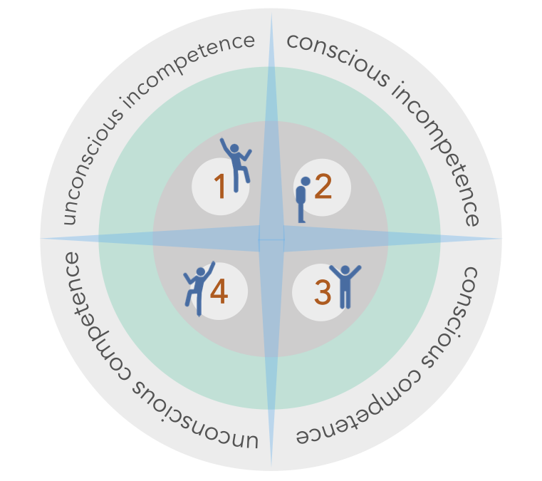
VIRTUAL EXTERNSHIPS
WHAT DOES THIS MEAN FOR OUR STUDENTS?
BECOMING & BELONGING
Career identity development
is a process.
We need inspiration and motivation to persist and see
challenges as growth not
road blocks.
10,000 HOURS OF PRACTICE!
5
Arizona Pathways to Prosperity
Notes:
As Malcom Gladwell illustrates in Outliers it takes 10,000 hours of practice to achieve mastery. As young people explore career paths and begin to develop their own identities, they move through an iterative awareness schema that are informed through lived experiences. Like all processes of identity formation and development, career identity formation asks us to move from a state of ignorance and through an often challenging state of awakening and awareness before we commit to learning and growth. (For examples in other domains see Tuckman’s stages of team formation, Peck’s community growth, or Helm’s racial identity schemas).
The work and responsibility of mentors and our larger community is to help young people navigate and persist through the uncertainty and challenge of the “storming” phase of identity development.
john a. powell reminds us that as humans with a deep emotional, intellectual, and psychosocial need to belong, we must go beyond simply providing opportunities. To succeed we need to belong. Belonging goes beyond access and inclusion. It is about forming bridging relationships, practicing radical empathy, and centering equity. Students need to see themselves welcomed and reflected in the communities they seek to join. And the communities need to be transformed by their presence. They need to feel like they belong.
https://belonging.berkeley.edu/johnpowell

Slide 6
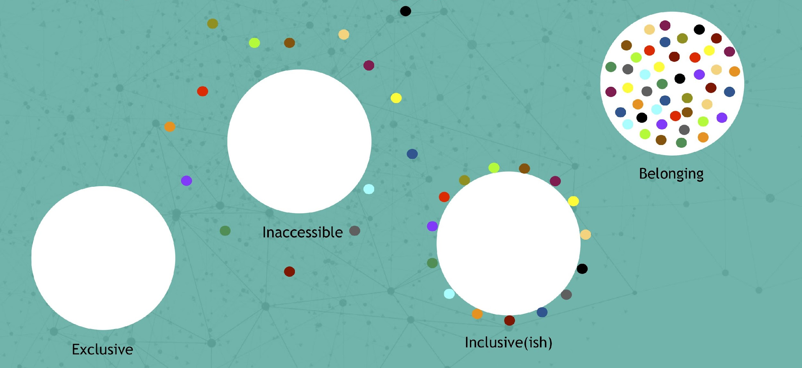
VIRTUAL EXTERNSHIPS
WHAT DOES THIS MEAN FOR OUR STUDENTS?
BECOMING & BELONGING
Persistence takes more than GRIT – we need positive reinforcement.
Compassion, gratitude
and pride give us support and persistence for free.
Career identity development
is a process.
We need inspiration and motivation to persist and see
challenges as growth not
road blocks.
Source: https://belonging.berkeley.edu. Retrieved October 2018
10,000 HOURS OF PRACTICE!
6
Arizona Pathways to Prosperity
Notes:
As Malcom Gladwell illustrates in Outliers it takes 10,000 hours of practice to achieve mastery. As young people explore career paths and begin to develop their own identities, they move through an iterative awareness schema that are informed through lived experiences. Like all processes of identity formation and development, career identity formation asks us to move from a state of ignorance and through an often challenging state of awakening and awareness before we commit to learning and growth. (For examples in other domains see Tuckman’s stages of team formation, Peck’s community growth, or Helm’s racial identity schemas).
The work and responsibility of mentors and our larger community is to help young people navigate and persist through the uncertainty and challenge of the “storming” phase of identity development.
john a. powell reminds us that as humans with a deep emotional, intellectual, and psychosocial need to belong, we must go beyond simply providing opportunities. To succeed we need to belong. Belonging goes beyond access and inclusion. It is about forming bridging relationships, practicing radical empathy, and centering equity. Students need to see themselves welcomed and reflected in the communities they seek to join. And the communities need to be transformed by their presence. They need to feel like they belong.
https://belonging.berkeley.edu/johnpowell

Slide 7

VIRTUAL EXTERNSHIPS
BREAKOUT!
                ~15 minutes
  Have a convo…
    How will you leverage this experience and the tools available to provide students with support and opportunities?
    What are your next steps?
7
Arizona Pathways to Prosperity

Slide 8
VIRTUAL EXTERNSHIPS
CHAT SHARE OUT
What were your highlights?
Biggest take-aways?
8
Arizona Pathways to Prosperity

Slide 9

VIRTUAL EXTERNSHIP WRAP UP!
VIRTUAL EXTERNSHIPS
THANK YOU!
WHAT TO EXPECT NEXT
Complete Externship Activities
Employer Sessions will be added in Resource Folder
PD Certificates and Stipends
9
Arizona Pathways to Prosperity

