Slide 1
Take a Stand Protocol
How to use this template:
Download a copy of this slide deck.
Search career on https://www.onetonline.org/
Select 2-3 facts about the career for each Lens.
Use these guiding questions to select career facts:
  Self: What skills, interests, or work styles might some in this career need to be successful?
  Security: What kind of education might someone need for this career? What are the wage and employment trends for this career?
  Society: How does this career intersect with values, lifestyles, and social/community issues?
Add the selected facts to the corresponding slides. Create "I statements" with each career fact to spark thinking and discussion.
Notes:
Determine how to edit for virtual (i.e. instead of lining up, place a dot/stick note/X, etc.), polling is another option?

Slide 2
Take a Stand
[Insert Career Title Here]
Self: What talents, skills, and values do they bring?
Security: What lifestyle is important to them, what real opportunities exist, and what realities do they need to thoughtfully navigate?
Society: What challenges does their community/generation face and how are they part of the solution?

Slide 3
Take a Stand Protocol
“Take a Stand” protocol:
a. After each statement is read, you will line up on a continuum based on how important the statement is to you.
b. One end of the continuum is very important, the other not important—think of it as a 0-100 space where you can fill in all of the quantities in between.
c. As each statement is read, reflect on how important each idea is to you and line up accordingly—fill in all along the line to reflect gradations of importance.
Notes:
Determine how to edit for virtual (i.e. instead of lining up, place a dot/stick note/X, etc.), polling is another option?

Slide 4

SELF
I can ...[insert statement about career. For example: I can communicate with a diverse audience about complex topics]
  [Insert fact about skills related to this career. For example: Marine Scientists provide technical information or assistance to public and advise others about environmental management or conservation.]
I can ...[insert statement about career]
  [Insert fact about skills related to this career]
I can ...[insert statement about career]
  [Insert fact about skills related to this career]
0
50
100
Notes:
Ask students to reflect

Slide 5
SECURITY
A median salary of around [insert average salary] would offer me the lifestyle I want
  [Insert fact about career salary range]
I am interested in [insert education requirement for this career]
  [Insert fact about career pathways]
0
50
100

Slide 6
SOCIETY
I am... [Insert statement about career values, lifestyle and/or social/community issues].
  [Insert fact about how this career intersect with values, lifestyles, and social/community issues]
I like...[Insert statement about career values, lifestyle and/or social/community issues].
  [Insert fact about how this career intersect with values, lifestyles, and social/community issues]
0
50
100

Slide 7
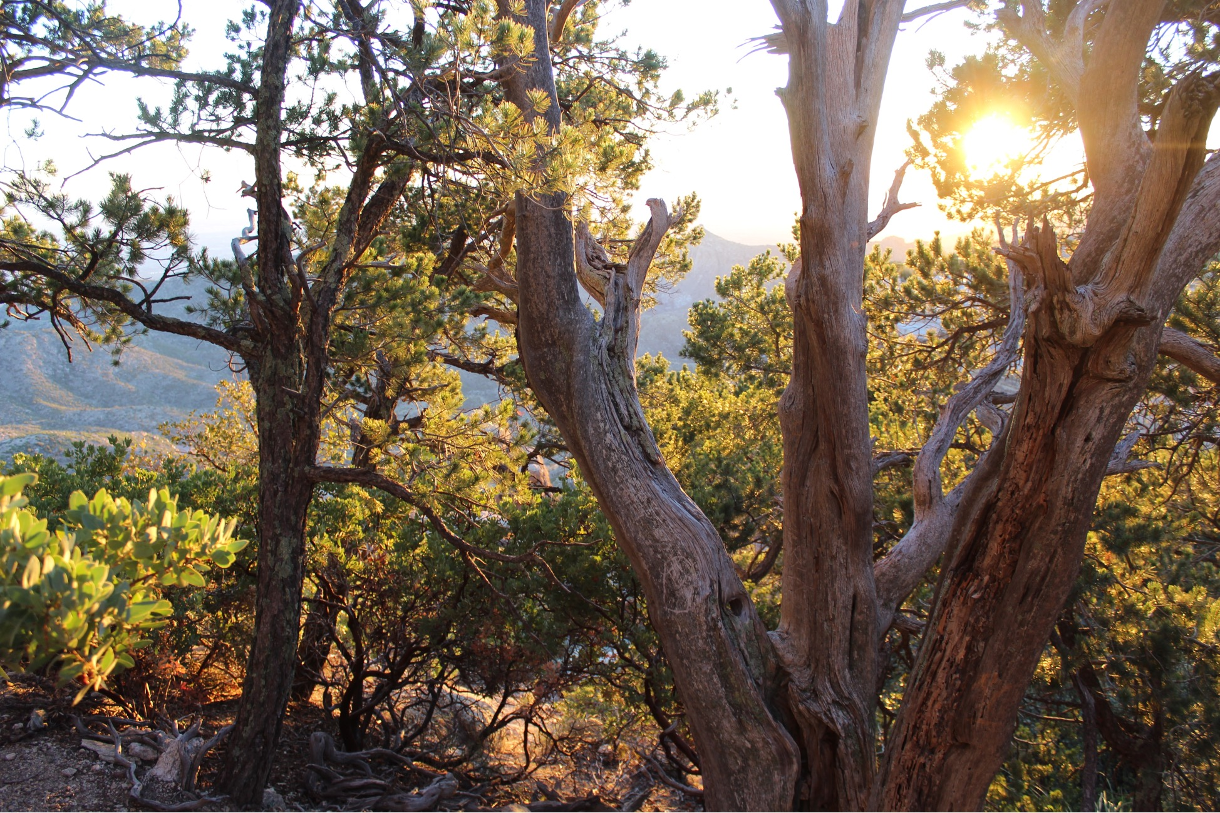
For questions contact:
Maya Watts
maya.watts@arizonafuture.org
Natalie Galarza
nngalarza10@gmail.com
Center for the Future of Arizona Arizona Pathways to Prosperity
‹#›

Slide 8
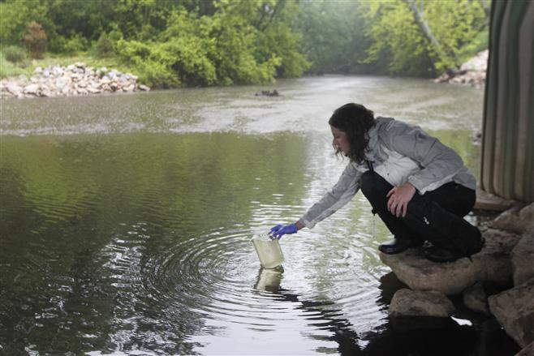
Take a Stand
Water Resource Specialist
Self: What talents, skills, and values do they bring?
Security: What lifestyle is important to them, what real opportunities exist, and what realities do they need to thoughtfully navigate?
Society: What challenges does their community/generation face and how are they part of the solution?
Example

Slide 9
Take a Stand Protocol
“Take a Stand” protocol:
a. After each statement is read, you will line up on a continuum based on how important the statement is to you.
b. One end of the continuum is very important, the other not important—think of it as a 0-100 space where you can fill in all of the quantities in between.
c. As each statement is read, reflect on how important each idea is to you and line up accordingly—fill in all along the line to reflect gradations of importance.
*FOR TODAY* As each statement is read, reflect on how important each idea is to you. Indicate how important it is to you using 0-10 on your fingers.
Example
Notes:
Determine how to edit for virtual (i.e. instead of lining up, place a dot/stick note/X, etc.), polling is another option?

Slide 10
SELF
I am comfortable working with and operating technology on a daily basis.
  A water resource specialist uses technology and machines in almost every aspect of their job.
I enjoy investigating and learning new things.
  Water resource specialists often need to figure out solutions to problems or figure out what’s wrong.
Example
0
50
100
Notes:
Ask students to reflect

Slide 11
SECURITY
I would like to enter a growing career field with a positive employment outlook
  Water resource specialists are in demand, with the number of available jobs projected to grow by 14 percent by the year 2026
A median salary of 124,000 would support the lifestyle I want for my future family.
  This is the annual median salary for water resource specialists.
Example
0
50
100

Slide 12
SOCIETY
I would like a career that helps the environment.
  Water resource specialists often test green technologies and solutions to preserve our number one resource.
I like knowing that my job protects people and keeps them safe.
  Water resource specialists work to identify and stop causes for water pollution and keep people safe and healthy.
Example
0
50
100

