Slide 1
Career Exploration Resources Demo
By Maya Watts

Slide 2






Possible futures
Curriculum modules
Skills for Success
STEM-ploration
Lenses on the future
Notes:
Add images/covers to each section
Jon

Slide 3



Skills for Success
The Skills for Success unit prepares students to gain the essential 21st-century skills of collaboration, communication, growth mindset, and self-regulation.
Best Practice | Sub Unit
All 12 lessons in order | Communication | Lesson 1: What is Communication?
 | Communication | Lesson 2: Listening to Understand
 | Communication | Lesson 3: Communication Bridges and Barriers
 | Communication | Lesson 4: Communication Skills That Pay the Bills
 | Collaboration | Lesson 5: Operation Collaboration
 | Collaboration | Lesson 6: Five Pillars of Effective Collaboration
 | Collaboration | Lesson 7: Collaboration Across Cultures
 | Collaboration | Lesson 8: The Win-Win Approach
 | Growth Mindset | Lesson 9: Celebrating Failure
 | Growth Mindset | Lesson 10: The Power of Yet
 | Self-Regulation | Lesson 11: The Hero and the Scholar
 | Self-Regulation | Lesson 12: The Myth of Multitasking

Slide 4
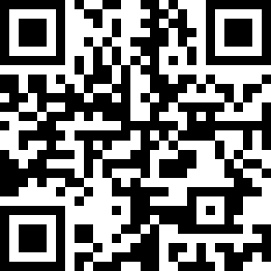
Preview Lesson
Collaboration: Lesson 8: The Win-Win Approach
https://tinyurl.com/winwinapproach

Slide 5




STemploration
Industry-specific Career Exploration
Health Science
Students learn about careers in the health sciences by taking on the role of health care professionals as they follow the treatment journey of a young person injured in a skateboarding accident.
Engineering and Design
Students assume the role of engineers as they learn to prototype, iterate, and innovate. Students are introduced to the design process, develop problem-solving and research skills, and learn to foster a growth mindset.
Information Technology
Students learn the fundamentals of computer programming, develop critical thinking skills, and practice collaboration as they take on the role of coders to design, develop, and market an app solution to a community need.
Cybersecurity
Students learn about careers in cybersecurity by exploring roles of cybersecurity professionals as they learn about digital citizenship, digital threats, ciphers, digital security, networking and communication protocols.

Slide 6


STemploration
Engineering and Design
Students assume the role of engineers as they learn to prototype, iterate, and innovate. Students are introduced to the design process, develop problem-solving and research skills, and learn to foster a growth mindset.
Best Practice | Condensed Unit | Introduction to Engineering
All 12 lessons in order | Lessons 1 through 6 in order & | Lessons 1 through 3 only | Lesson 1: Introduction to Engineering
 |  |  | Lesson 2: Engineering and Design 101
 |  |  | Lesson 3: Engineering and Design Process
 |  |  | Lesson 4: Water Crisis and Research
 |  |  | Lesson 5: Brainstorming a Solution
 |  |  | Lesson 6: Water Purification
 |  |  | Lesson 7: Zip Line
 |  |  | Lesson 8: Airdrop
 |  |  | Lesson 9: Shelter
 |  |  | Lesson 10: Towers
 | Student Presentations and/or Closure |  | Lesson 11: Presenting Your Designs
 |  |  | Lesson 12: Engineering Sciences Closure

Slide 7

STemploration
Health Sciences
Students learn about careers in the health sciences by taking on the role of health care professionals as they follow the treatment journey of a young person injured in a skateboarding accident.
Best Practice | Mini Unit | Introduction to Health Sciences
All 12 lessons in order | Lessons 1 through 5 | Lessons 1 through 3 only | Lesson1: Introduction
 |  |  | Lesson 2: Respiration
 |  |  | Lesson 3: Exploring the Emergency Room
 |  |  | Lesson 4: The Skeletal System
 |  |  | Lesson 5: Blood and the Human Body
 |  |  | Lesson 6: Skin our Body’s Largest Organ
 |  |  | Lesson 7: The Operating Room & Disease Risk
 |  |  | Lesson 8: Biomechanics
 |  |  | Lesson 9: Occupational Therapy
 |  |  | Lesson 10: Mental Health and Healing
 |  |  | Lesson 11: Safety and Epidemiology
 |  |  | Lesson 12: Closure
Pairs: Lessons 8 & 9; Lesson 3 & 11; Lessons 7 & 11; Lessons 1 & 8
Trios: Lessons 4-6; Lessons 2-4

Slide 8

STemploration
Information Technology
Students learn the fundamentals of computer programming, develop critical thinking skills, and practice collaboration as they take on the role of coders to design, develop, and market an app solution to a community need.
Best Practice | Mini unit (No App) | Introduction to IT (No App)
All 12 lessons in order | Lessons 1 & 2, and | Lessons 1 through 3 only | Lesson 1: Introduction
 |  |  | Lesson 2: The World of Coding
 |  |  | Lesson 3: Coding Apps
 | Lessons 4 & 5 only |  | Lesson 4: Looking Critically at Apps
 |  |  | Lesson 5: User Interface Design
 |  |  | Lesson 6: Ideating Prototypes
 |  |  | Lesson 7: Wireframing
 |  |  | Lesson 8: Coding Your App
 |  |  | Lesson 9: Testing Your App
 |  |  | Lesson 10: Marketing and Branding
 |  |  | Lesson 11: Presenting Your App
 |  |  | Lesson 12: Closure
Pairs: Lessons 2 & 3; Lessons 4 & 6; Lessons 3 & 4; Lessons 4 & 5
Trios: Lessons 3 – 5; Lessons 4 – 6
Stand alone: Lesson 4

Slide 9


Cybersecurity
Students learn about careers in cybersecurity by exploring roles of cybersecurity professionals as they learn about digital citizenship, digital threats, ciphers, digital security, networking and communication protocols.
Best Practice | Mini Unit
All 12 lessons in order | Lessons 1 through 5 | Lesson 1: Digital Life
 |  | Lesson 2: Cyber Threats
 |  | Lesson 3: Threat Prevention
 |  | Lesson 4: Introduction to Cybersecurity
 |  | Lesson 5: Physical and Digital Security
 |  | Lesson 6: Passwords
 |  | Lesson 7: Intro to Networking
 |  | Lesson 8: Protocols
 |  | Lesson 9: Intro to Encryption and Ciphers
 |  | Lesson 10: Types of Cyphers
 |  | Lesson 11: Encryption Methods
 |  | Lesson 12: Ethical Hacking
Stand Alone: 1, 2, 3, 4, 5, 6, 7, 8, 9, and 12
Trio: Lesson 9 - 11

Slide 10

Things to know about
STEMploration Units
Career Gallery Walks
Hands on Activities
Professional Skills
Take A Stand Activities (Reflection)
Embedded Learning Checks
Connect to MFAZ for MORE Exploration!
In-person and virtual adaptions!
Complementary Edge Factor Playlist!

Slide 11


Possible Futures Playlist
https://edgefactor.com/possible-futures

Slide 12



LENSES ON THE FUTURE
Self: What talents, skills, and values do they bring?
Security: What lifestyle is important to them, what real opportunities exist, and what realities do they need to thoughtfully navigate?
Society: What challenges does their community/generation face and how are they part of the solution?
Best Practice | Sub Unit
All 12 lessons in order | Self | Lesson 1: The Me I Choose
 | Self | Lesson 2: My Strengths and Talents
 | Self | Lesson 3: Connecting Careers
 | Self | Lesson 4: Six Word Statements
 | Security | Lesson 5: Future Ready Pathways
 | Security | Lesson 6: Job, Job, Career
 | Security | Lesson 7: Keeping It Real
 | Security | Lesson 8: Holland Codes
 | Society | Lesson 9: My Personal Brand
 | Society | Lesson 10: Values Hold ‘Em
 | Society | Lesson 11: Finding Contribution
 | Reflection | Lesson 12: Reflecting on the Lenses on the Future

Slide 13

Lenses on the Future + My Future Az = ECAP
Identify skills, interests, & values.
Document post secondary goals.
Define a career goal aligned to personal interests, skills, & values.
Explore educational requirements/ pathways to achieve the career goal.
Reflection Activities/ Journal Prompts
Upload PF Reflection Activities

Slide 14

Bring LIVE Labor Market Information into your classroom using this Arizona-specific Career Exploration tool.
www.myfutureaz.com

Slide 15
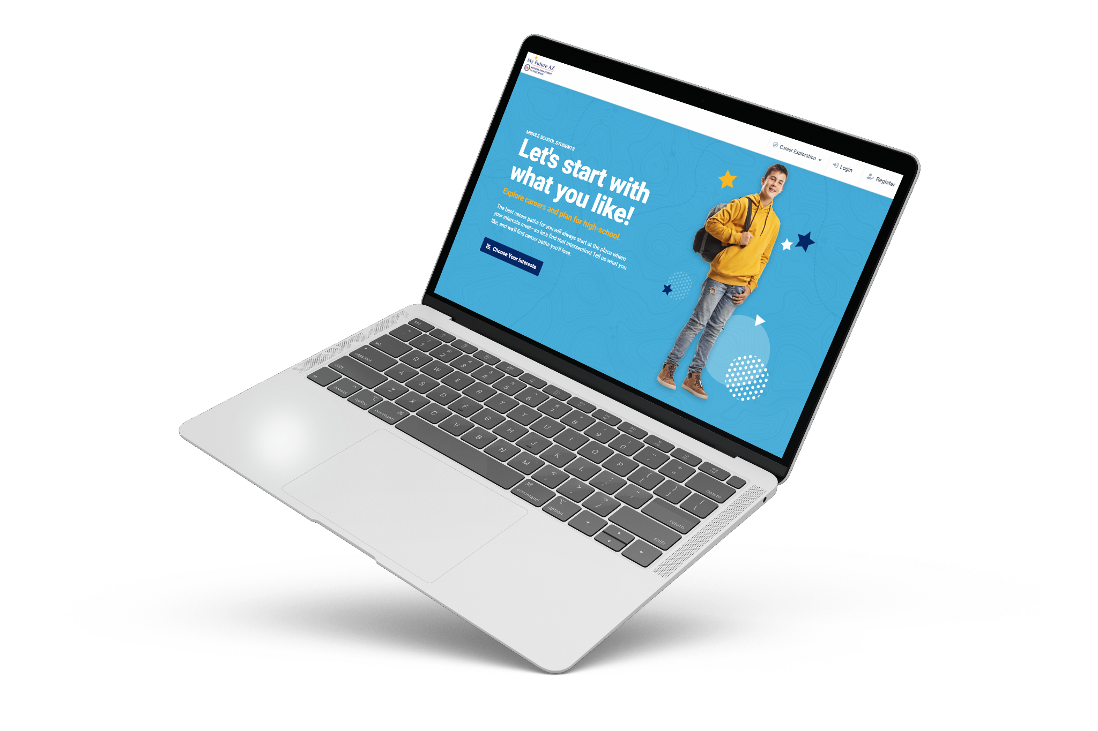

My Future AZ is the Recommended ECAP Replacement Tool For AzCIS.
My Future AZ utilizes proven technology and infrastructure from Pipeline AZ to offer students comprehensive resources and support to plan for their future careers.

Slide 16





8th Grade ECAP
By the end of 8th grade, middle school students should...
Develop an “8th-grade ECAP” that includes completing a career assessment, identifying possible careers, building out a career profile, and creating a 4–6-year educational plan.
Increase self-awareness and begin to incorporate occupational interests into self-identity.
Develop awareness and interpersonal connections to the world of work through experiences with potential employers, professional role models, and mentors.
Gain exposure to and awareness of local and national career opportunities and career clusters.
Develop professional skills as outlined in the 5-8 Career Literacy Standards
Source: ADE My Future AZ Middle School Get Started Guide

Slide 17
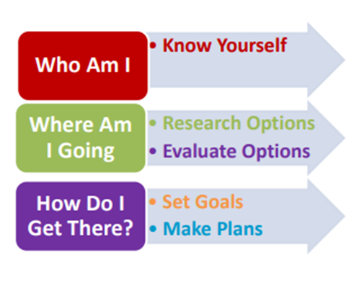
ECAP Implementation Plan
My Future Az ECAP Guide for Middle School
High School Guide Under Development

Slide 18

Implementation Ideas

Slide 19



How to implement Possible Futures
School Level
Career Literacy Elective Class
Advisory Period
Freshman CTE 101
Semester-long Course
Mandatory for all 8th graders
72 PF lessons ≈ 18 wks of curriculum
Daily 30 min Advisory Period
Skills & Lenses
STEM into core content classes:
E & D in Math
Daily class for 1 semester
All STEM units
Begin the ECAP
Intro to on-campus CTE opportunities

Slide 20
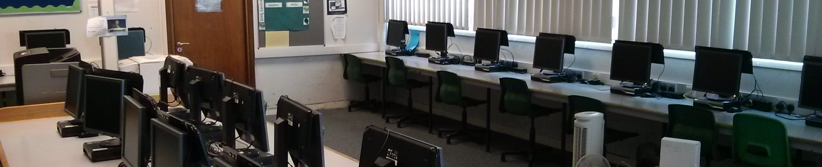
Computer Science Class?
Use some or all of the lessons from these two STEMploration Units:
Information & Technology and Cybersecurity
This Photo by Unknown Author is licensed under CC BY-SA

Slide 21
ECAP in 20 Class Periods
Lenses on the Future
All 12 lessons
STEM Career Introduction
Engineering & Design: Lesson 1
Health Sciences: Lesson 1
Skills for Success
Lesson 4: Communication Skills that Pay the Bills
Lesson 12: The Myth of Multitasking
Information Technology: Lesson 1
Cybersecurity: Lesson 4
Lesson 9: Celebrating Failure
Lesson 7: Collaboration Across Cultures

Slide 22
Lesson Combinations—Career Literacy Course
Smaller Scope & Sequences:
10 lessons
24 lessons
32 lessons
ECAP & Exploration
Career Literacy Foundations
Lenses on the Future
Career Literacy
Introduction to STEMploration
Select Lenses on the Future Lessons
Introduction to STEMploration
Lenses on the Future
Skills for Success
Skills for Success

Slide 23
Thank You
Maya Watts, maya.watts@arizonafuture.org
arizonafuture.org
October 22, 2020

Slide 24


Access
Possible Futures on the
Arizona Pathways to Prosperity Hub
https://cte.ctecaz.org/hubs/pathways
Looking for your account info? Search for an email from support@ctecaz.org

