Slide 1
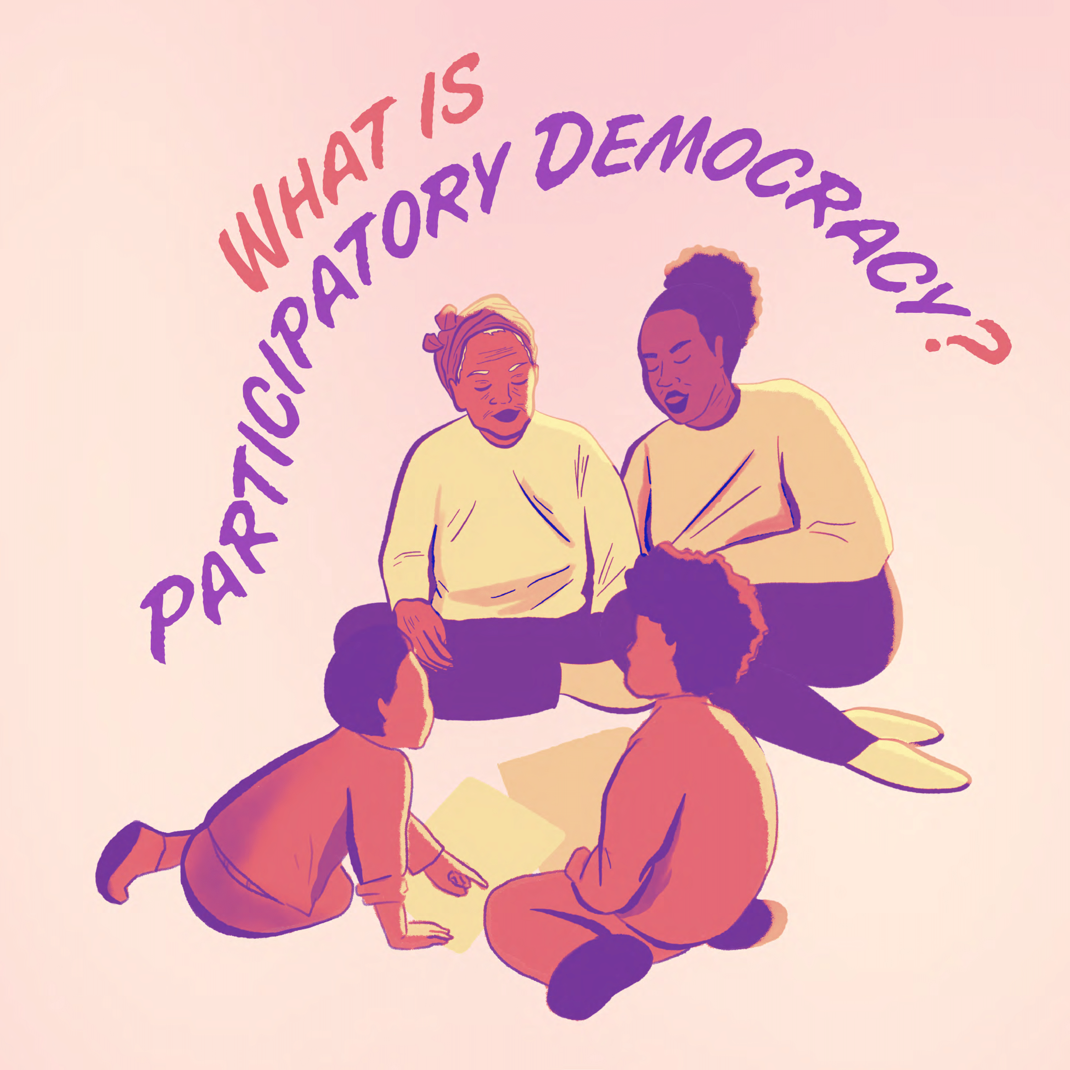

Slide 2
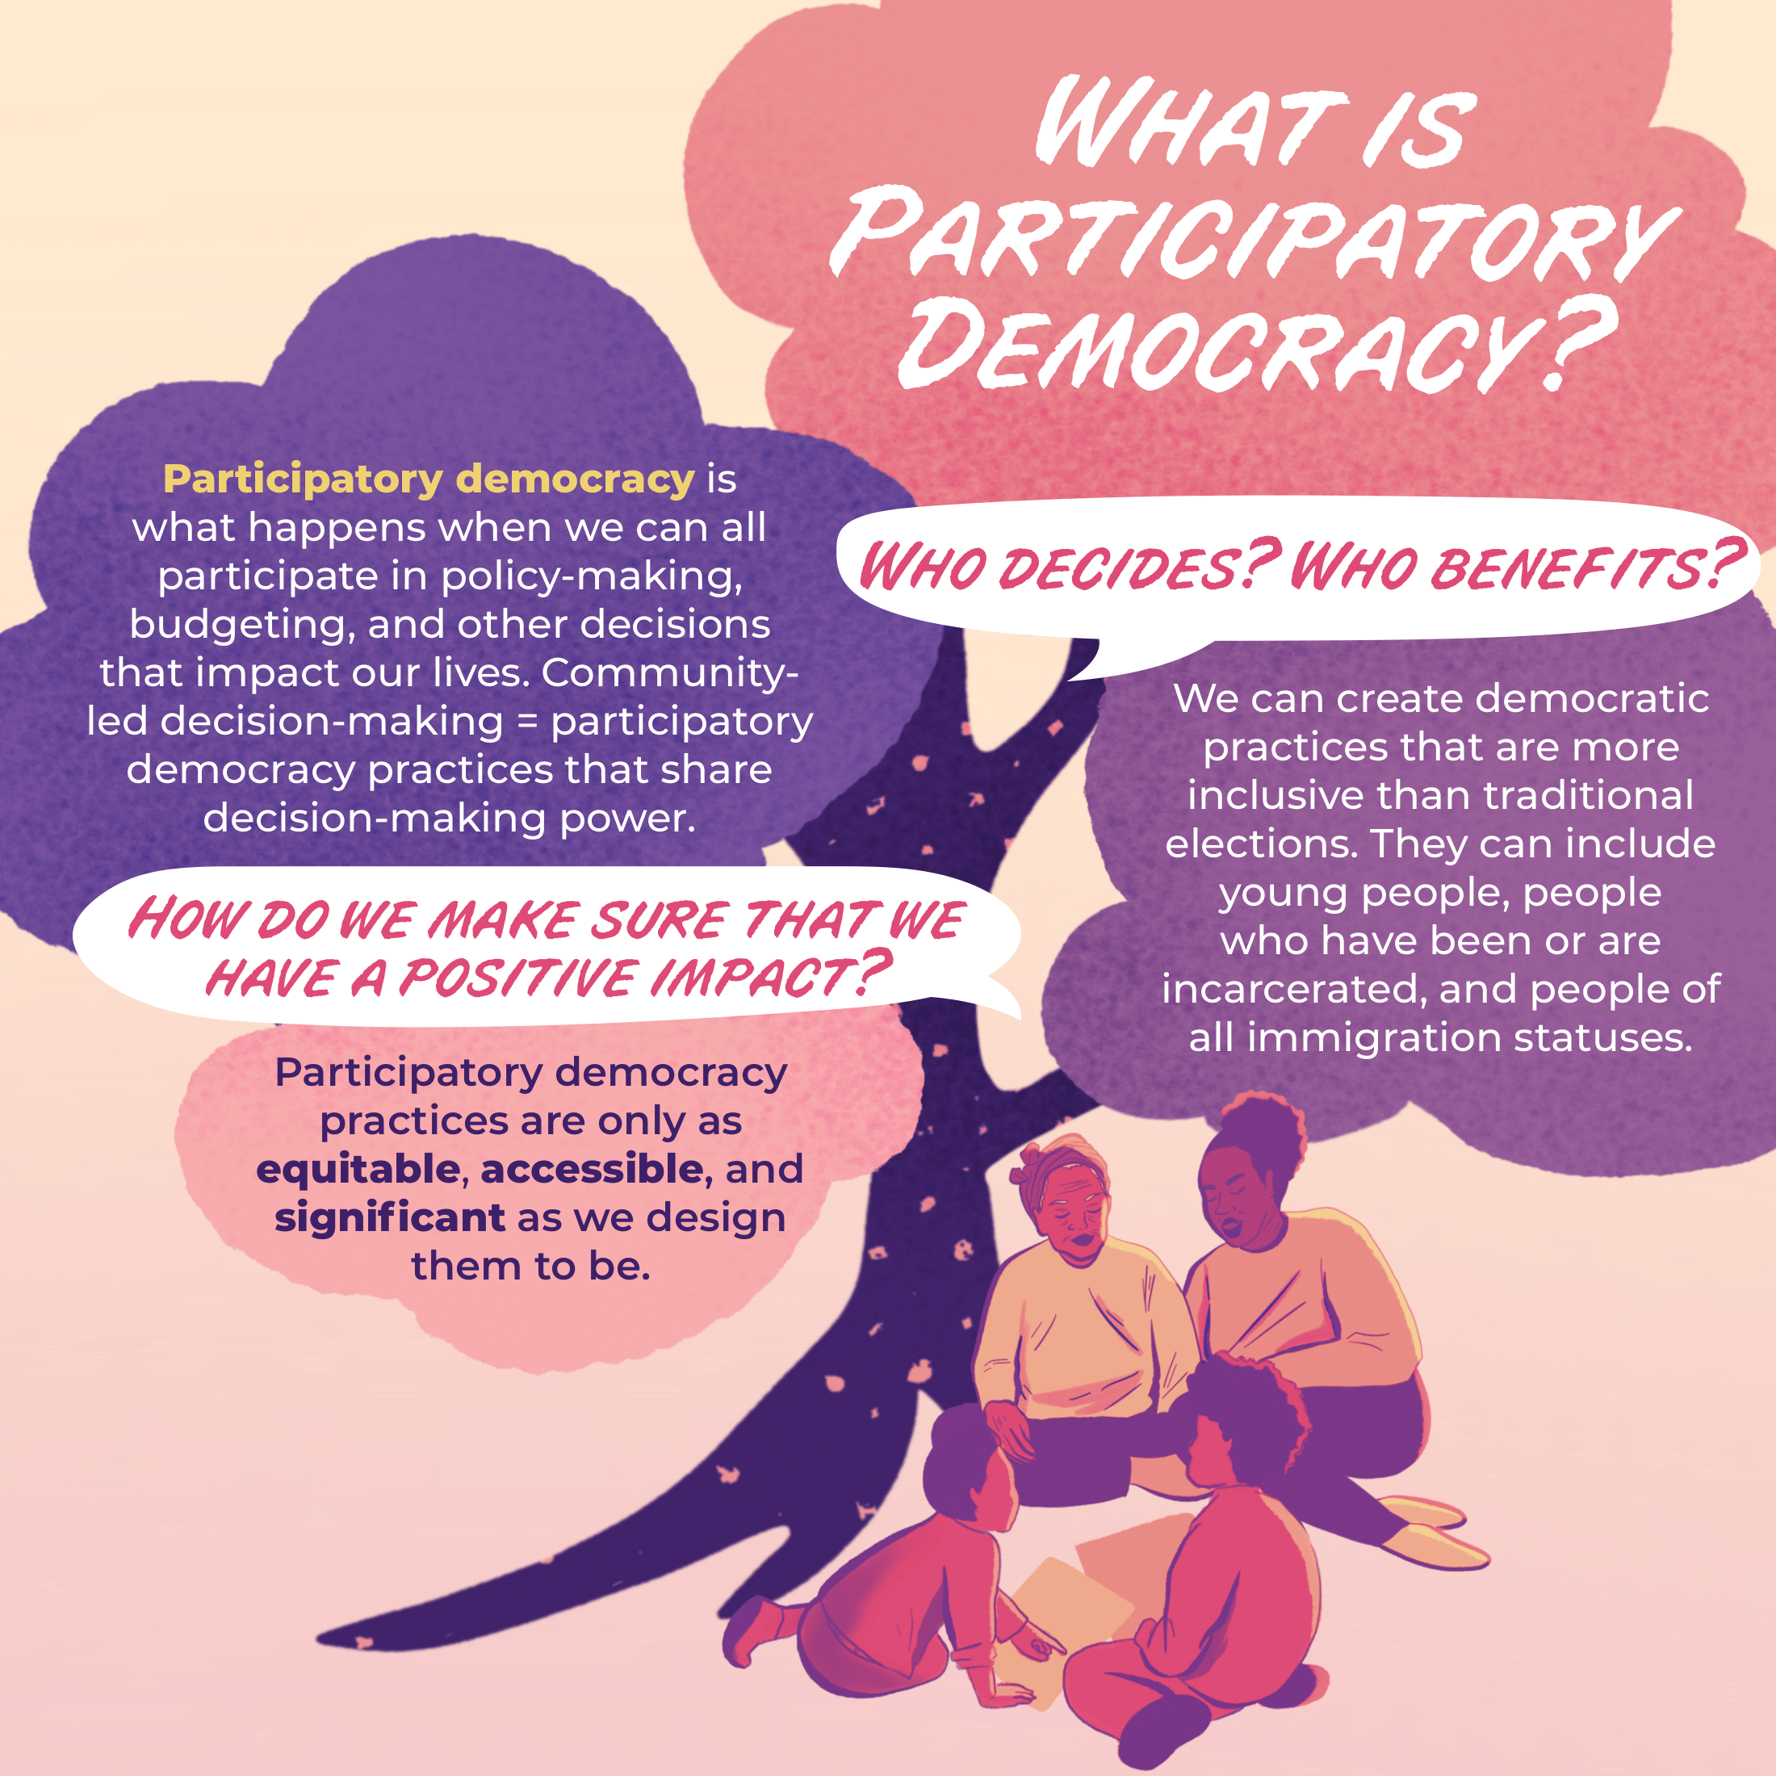

Slide 3
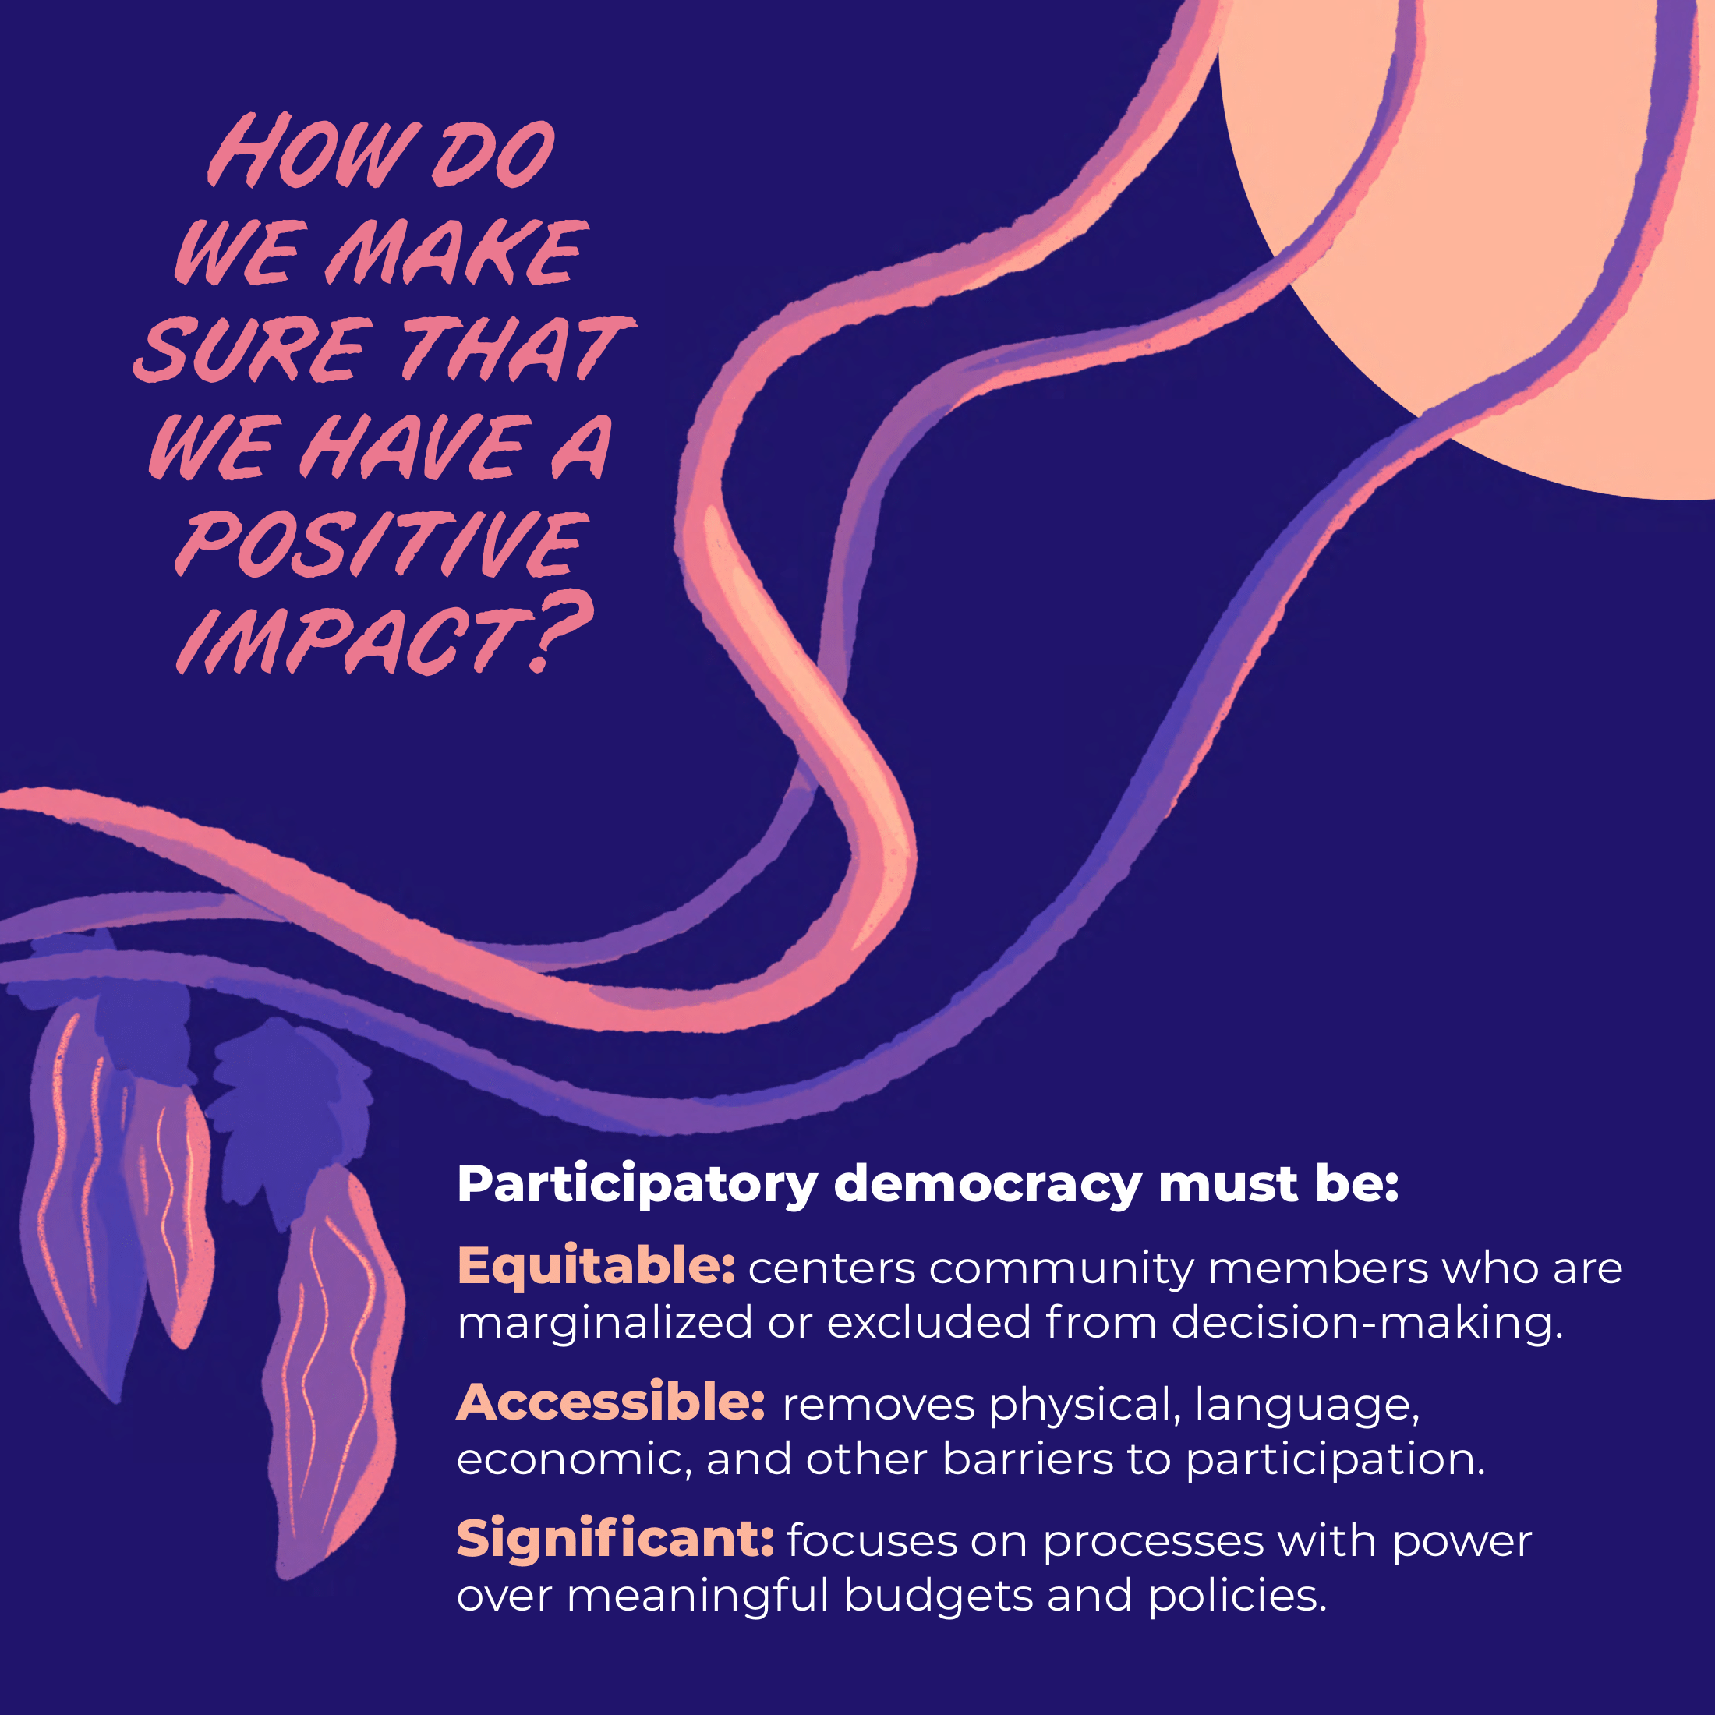

Slide 4
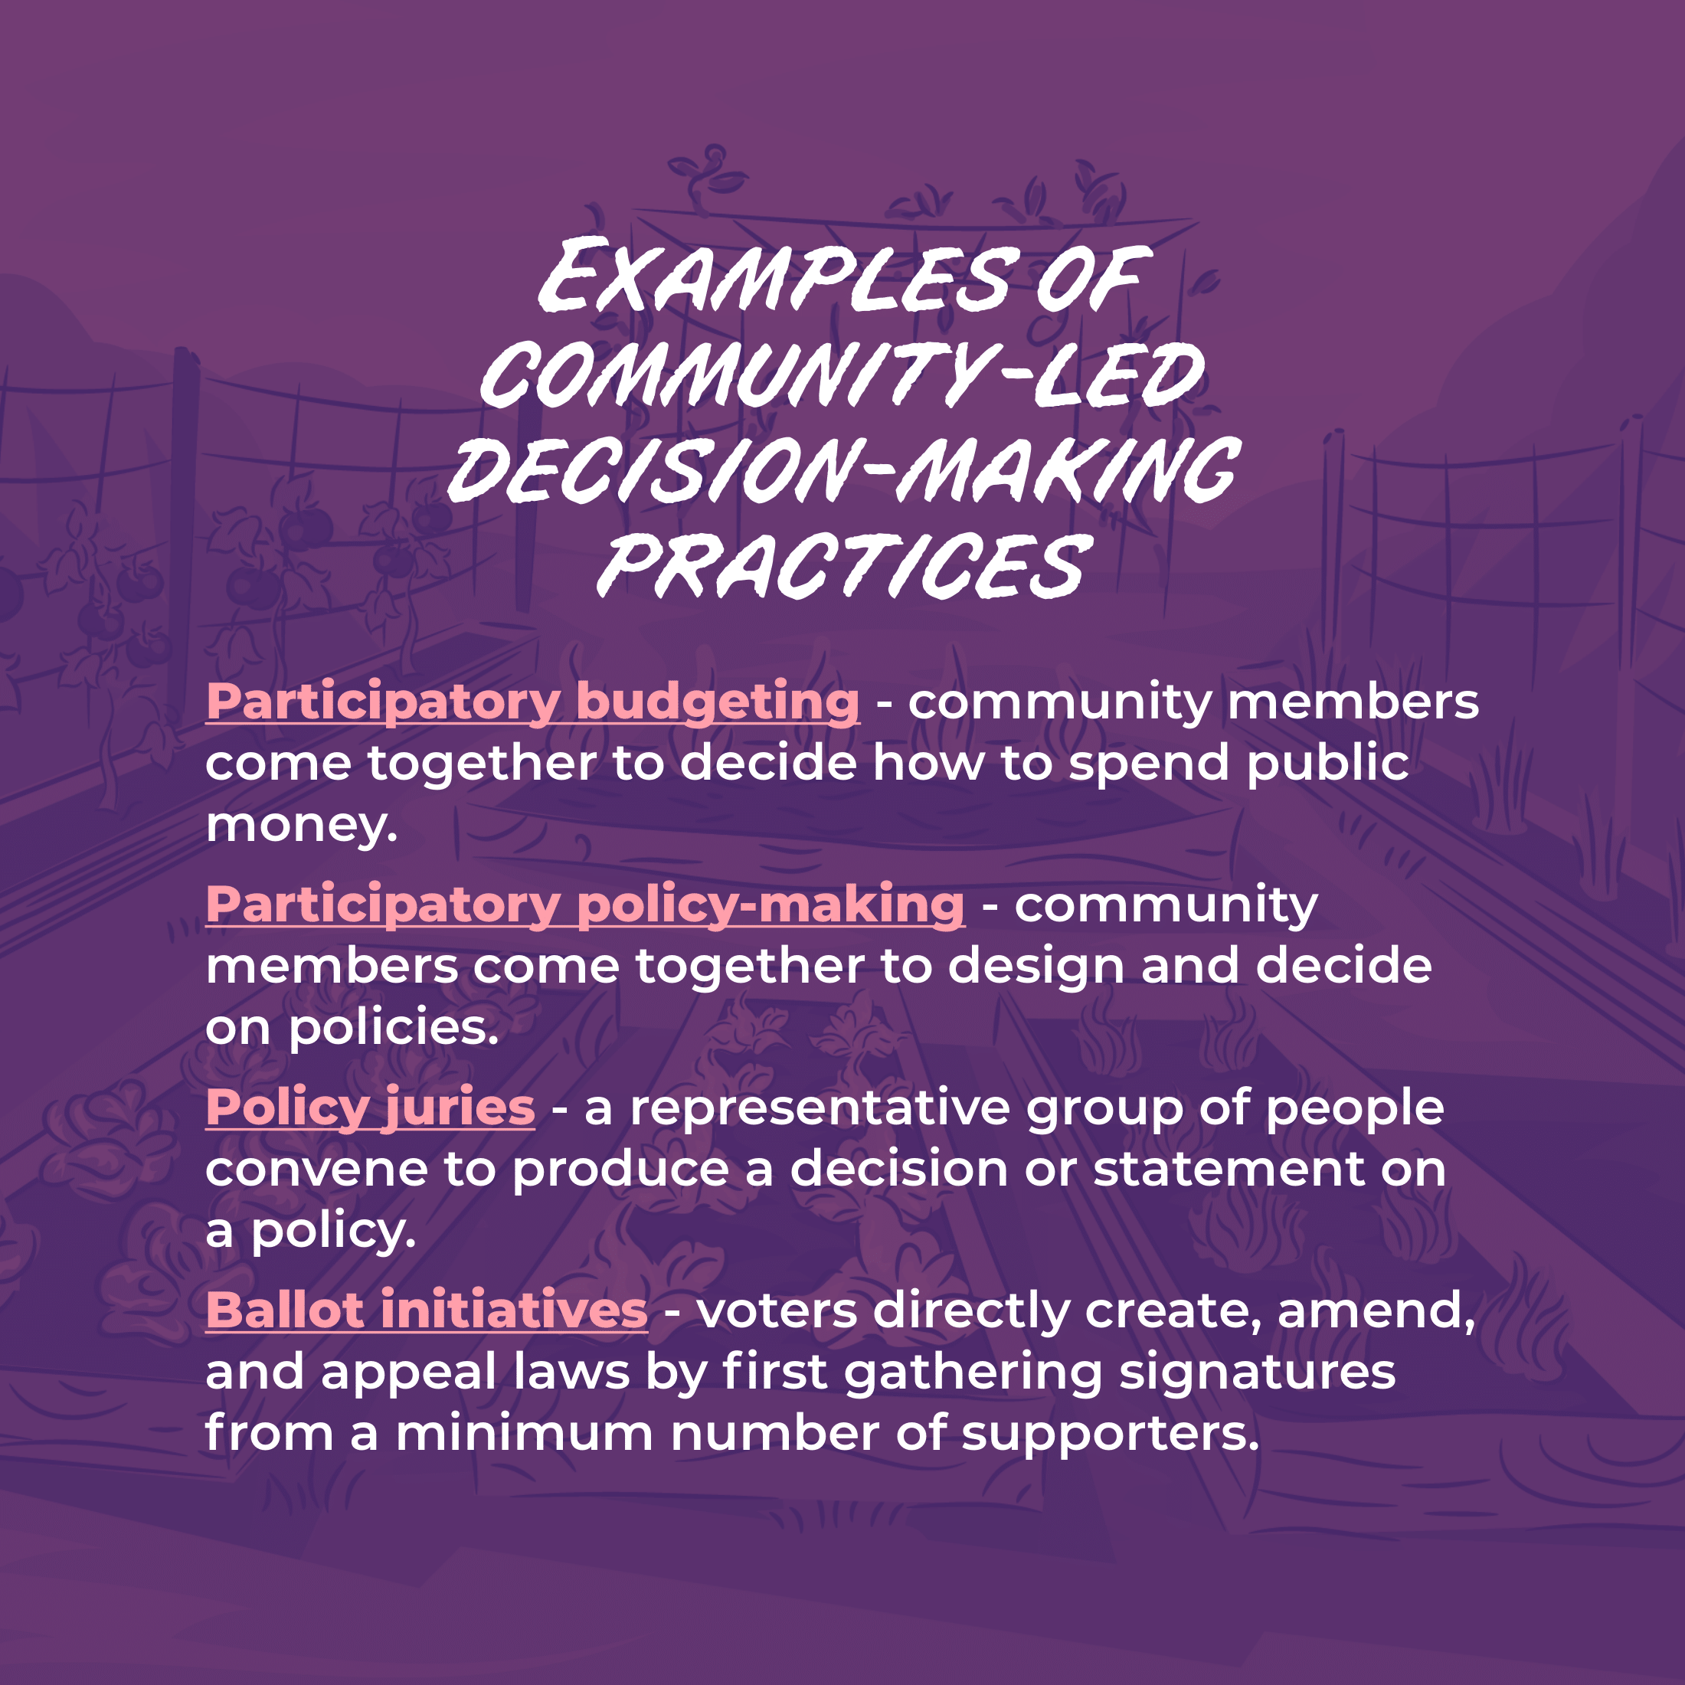

Slide 5
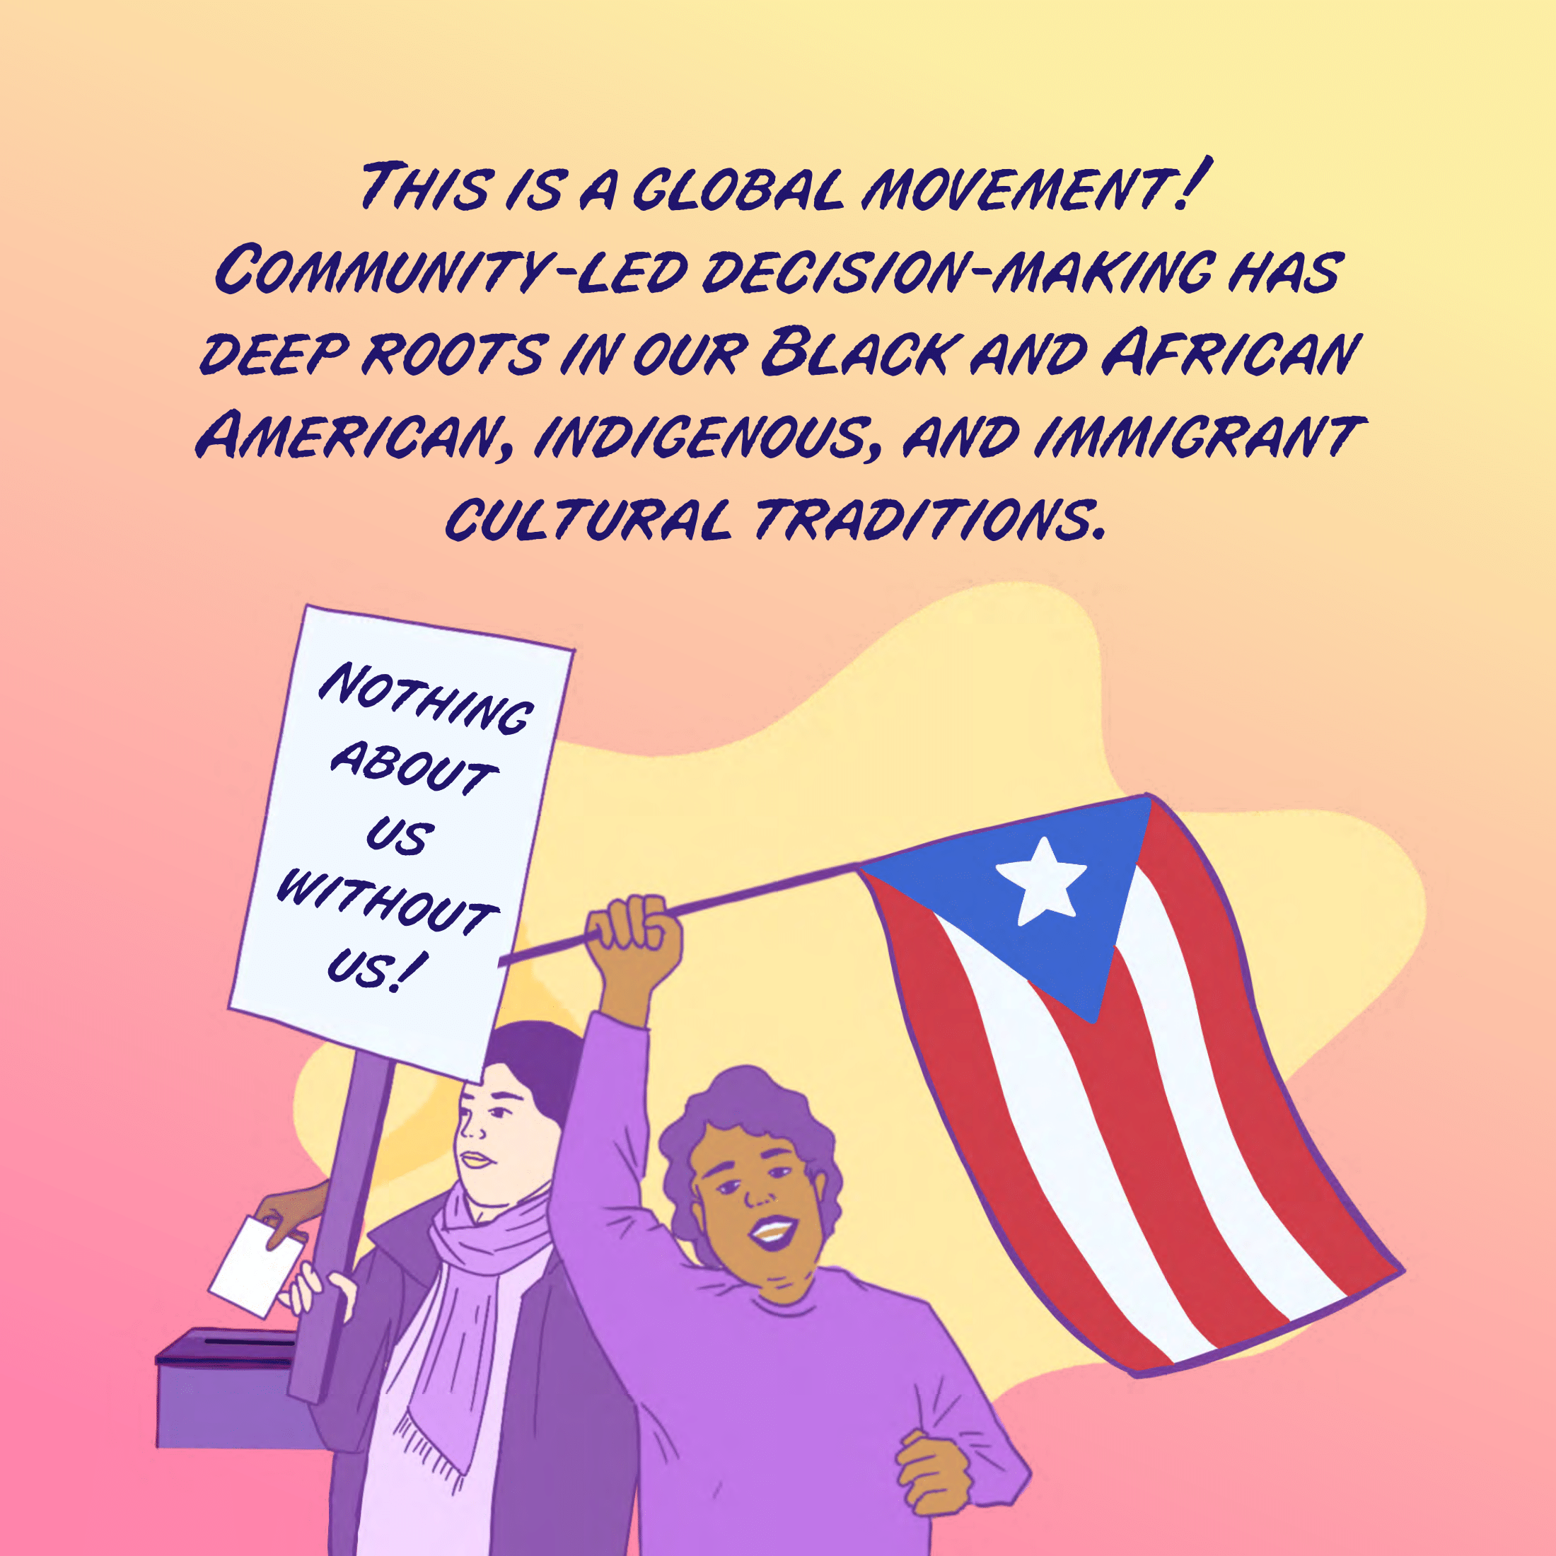

Slide 6
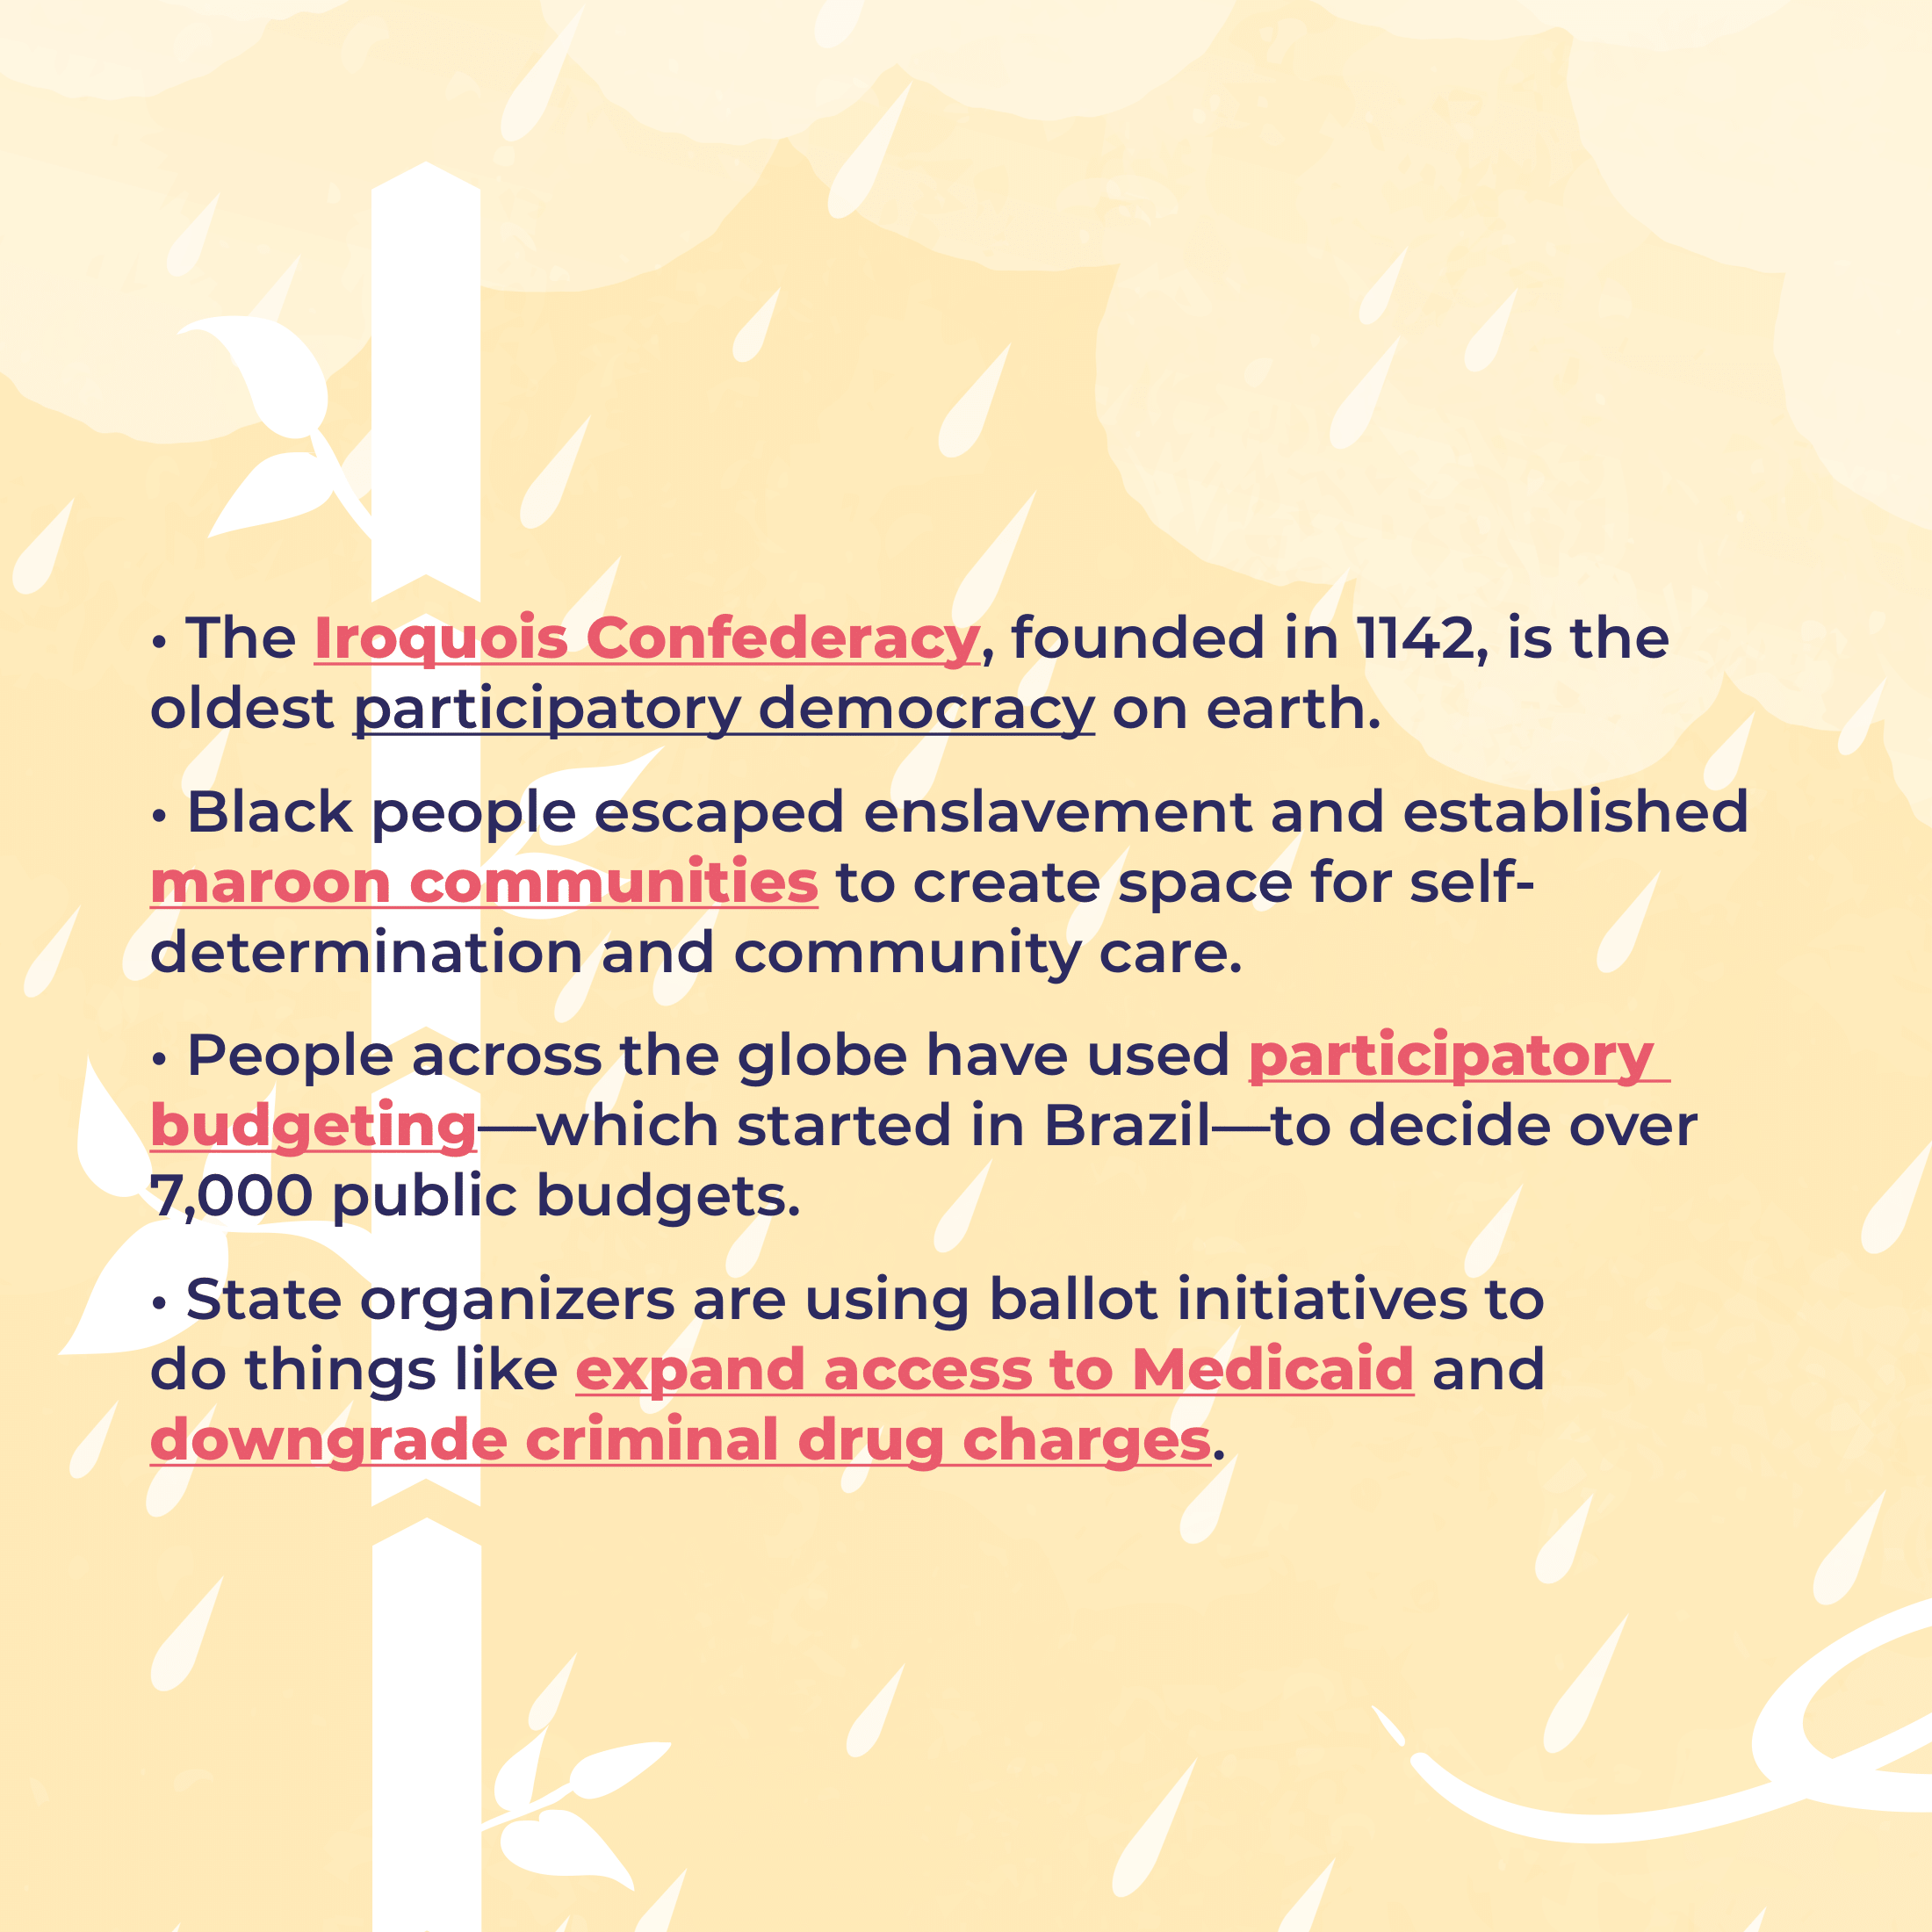
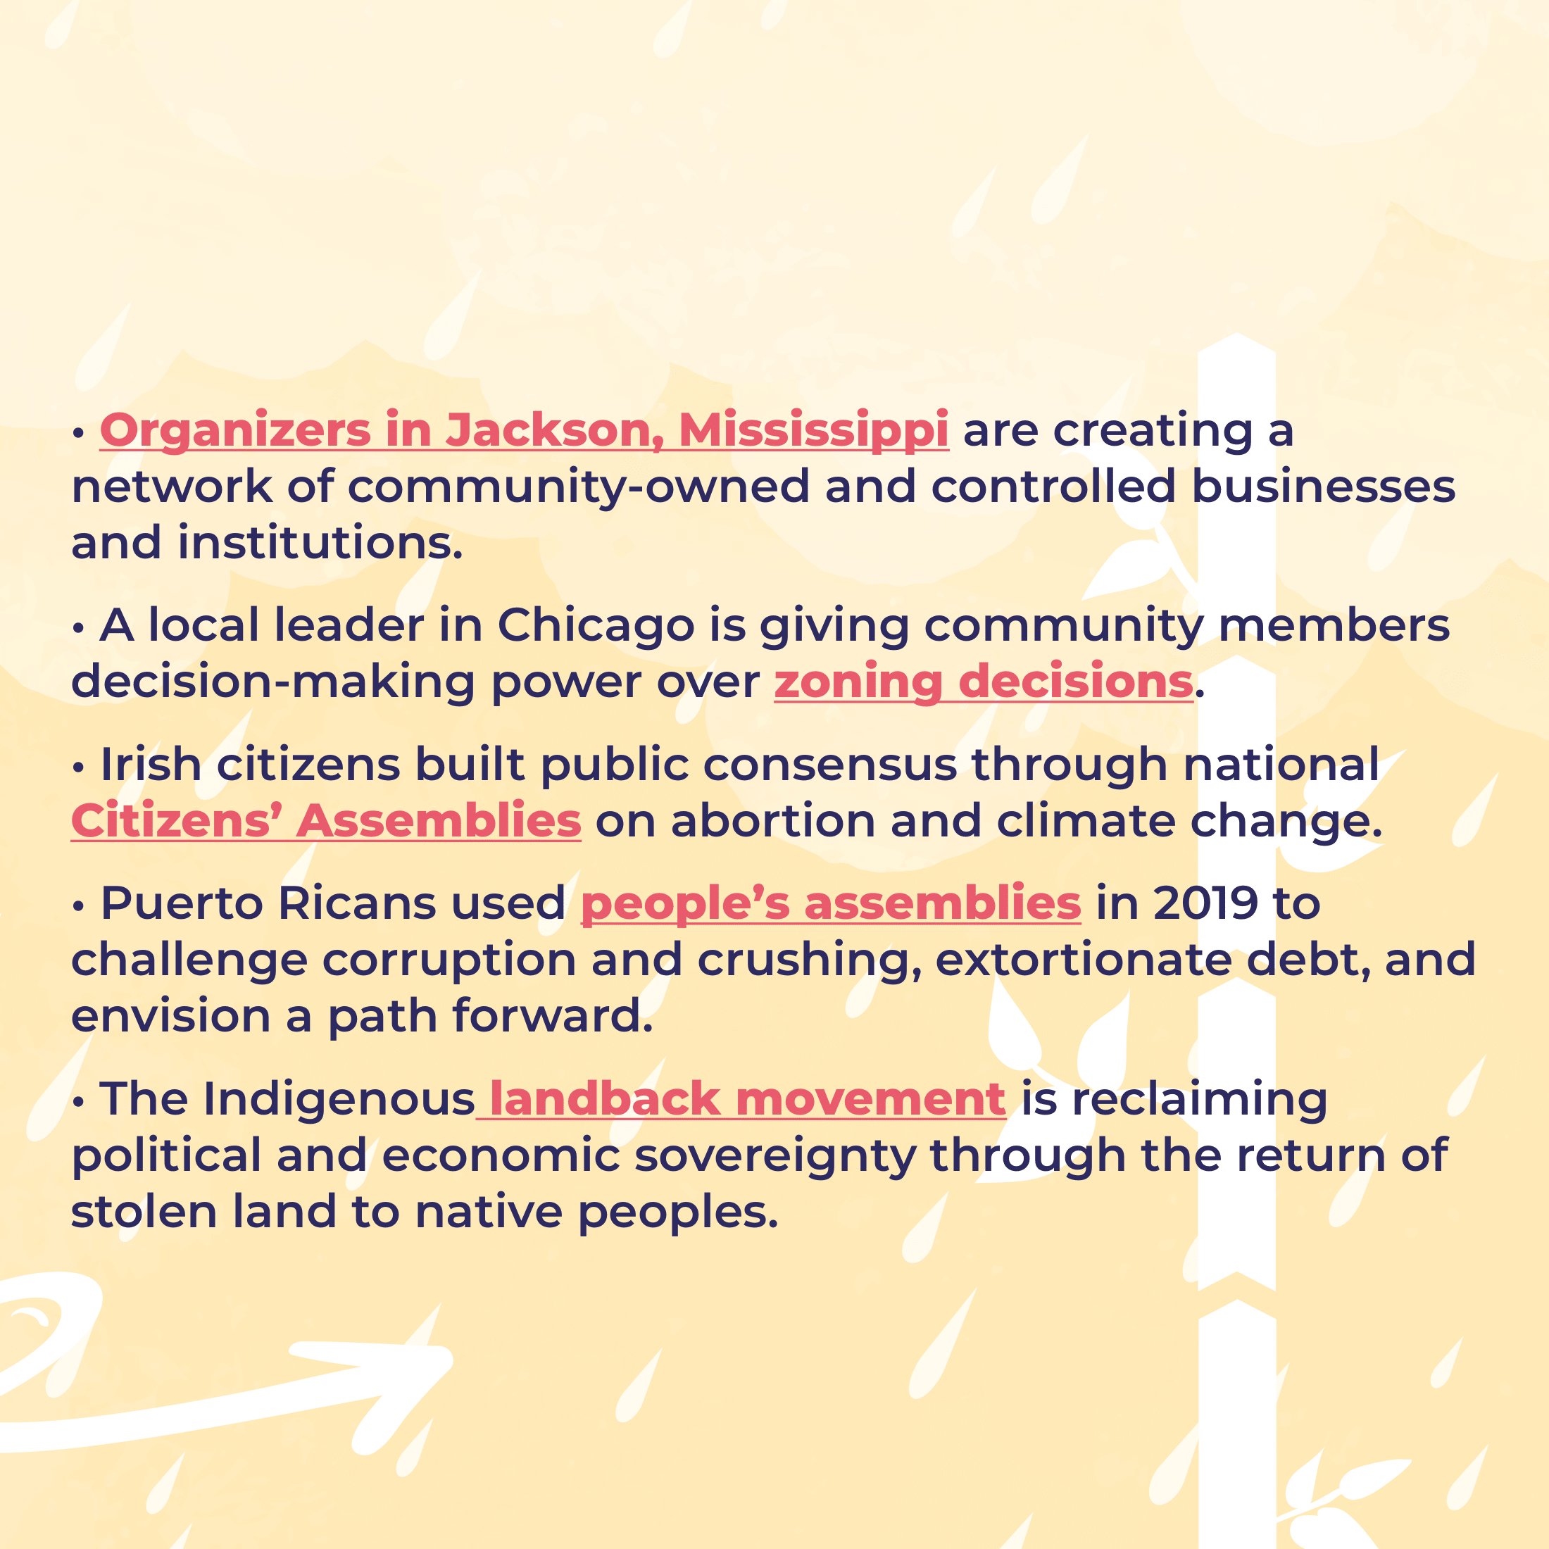
Examples of Participatory Democracy Across the Globe

Slide 7
Discussion Questions:
What does participatory democracy mean to you? How does it look? How does it feel?
Have you seen or experienced examples of participatory democracy in your school or community?
What is your favorite example of participatory democracy in history?
Suggested Activities:
Create a representation (drawing, poem, scene in a movie, etc.) of what participatory democracy means to you.
Develop a proposal for a way in which participatory democracy can be used in your classroom, school, or community.
Share your ideas with others and join the conversation at #participatory democracy.

Slide 8
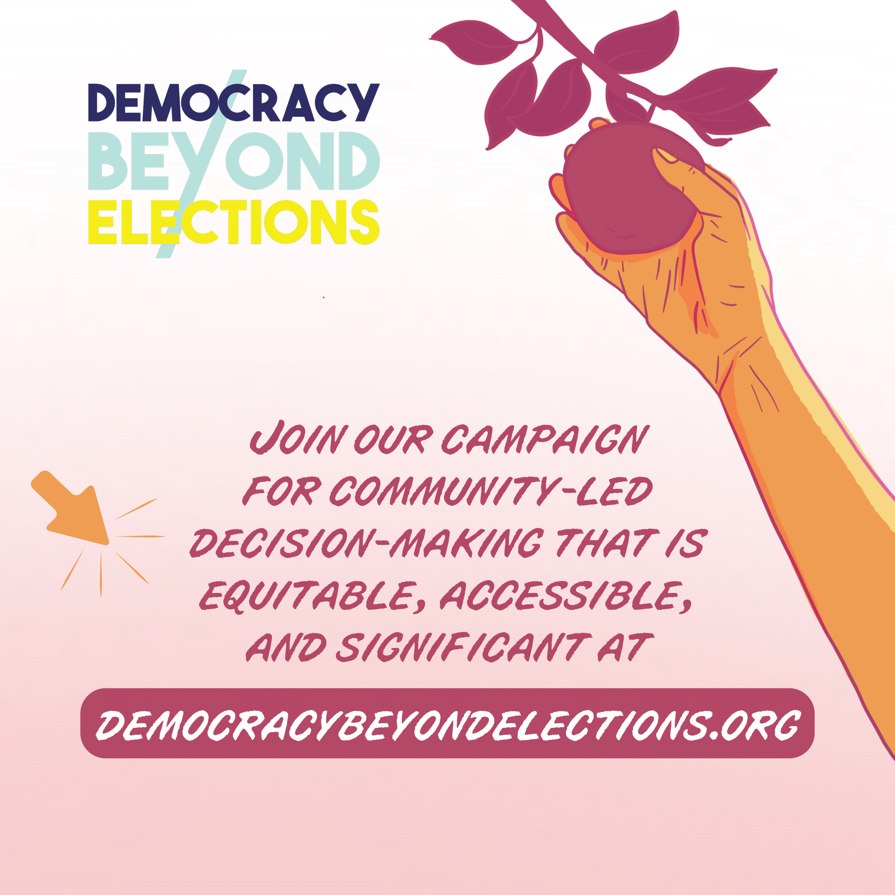
How can I use this resource?
This resource can be used to prompt dialogue and deliberation around the concept of participatory democracy.
Who is this resource designed for?
This resource is designed for people who want to learn more about community-led decision-making. You might use this resource in a classroom to teach students about participatory budgeting or a community workshop to prompt community-driven action.
Who created this resource?
This graphics and discussion questions included in this resource were created by members of the Democracy Beyond Elections Coalition.

