Slide 1






VIRTUAL EXTERNSHIPS
SUPPORT
structures
MINIMAL TIME
EXTERNSHIP KICK-OFF
8:00 - 9:00 am
DAY, DATE
commitment
NETWORK
connections
CAREER PATHWAYS
exploration
REMOTE
access
Arizona Pathways to Prosperity

Slide 2

VIRTUAL EXTERNSHIPS
RESOURCES
GOOGLE DRIVE
KICK-OFF AGENDA
Participant contact info
Externship schedule w/ join links
Externship project assignments
Welcome
Logistics
Group Anchoring
Breakout Convos
Externship Project Info
Wrap up
Resources Link in Chat and Email
Arizona Pathways to Prosperity

Slide 3


VIRTUAL EXTERNSHIPS
THE SCHEDULE
 | Monday | Tuesday | Wednesday
8:00 | Kick-off | Employer Session | Employer Session
9:00 | Employer Session | Employer Session | Employer Session
10:00 | Employer Session | Employer Session | Employer Session
11:00 | Employer Session | Employer Session | Worktime
 |  |  | Employer Session
12:00 | Worktime | Worktime | Wrap Up Session
Arizona Pathways to Prosperity
Notes:
CINDY

Slide 4
VIRTUAL EXTERNSHIPS
What do your students want to know about the world of work?
Answer in CHAT
Arizona Pathways to Prosperity

Slide 5
VIRTUAL EXTERNSHIPS
What specific info do you hope to bring back to your students?
Answer in CHAT
Arizona Pathways to Prosperity

Slide 6
VIRTUAL EXTERNSHIPS
WHAT DO WE KNOW?
Arizona Pathways to Prosperity
Notes:
IT - Arizona is an emerging tech market, home to 9,563 technology companies, 198,821 tech jobs, and $21.75 billion in total tech industry wages*. However, since the Great Recession, the average number of new computer occupations jobs per year is larger than the combined total of graduates from information technology programs across every institution in the region**.
CYber - Arizona is home to a booming technology industry, which is naturally complemented by the need for cybersecurity professionals. With over 12 thousand job openings* in Arizona at all levels, needed to protect the integrity of the region’s online presence.

Slide 7


VIRTUAL EXTERNSHIPS
WHAT DO WE KNOW?
1990
89% of employers report difficulty finding employees with the requisite skills for job openings.
2020
89%
~40% of recent college graduates are underemployed, working in jobs that do not require their level of training.
The standard high school diploma
offers 50% fewer opportunities to find
family-sustaining careers than it did in 1990
40%
“We’re flooding people with information—but we don’t have the right structures in place to help them connect the dots that lead through education to career.”
Source: http://forbes.com, 2020
Arizona Pathways to Prosperity
Notes:
In McKinsey’s global survey of 800 senior executives in July 2020, two-thirds said they were stepping up investment in automation and AI either somewhat or significantly.16

Slide 8
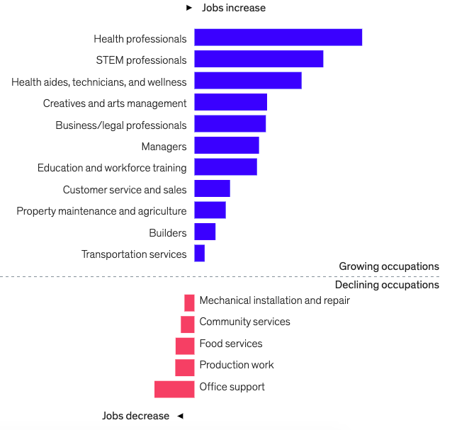
VIRTUAL EXTERNSHIPS
WHAT DO WE KNOW?
JOBS affected by AUTOMATION and TECH
AZ workforce reality reflects national
Future of Work projections affected by AUTOMATION and other
TECHNOLOGY INNOVATIONS.
Source:
https://www.mckinsey.com/featured-insights/future-of-work
Arizona Pathways to Prosperity
Notes:
In McKinsey’s global survey of 800 senior executives in July 2020, two-thirds said they were stepping up investment in automation and AI either somewhat or significantly.16

Slide 9
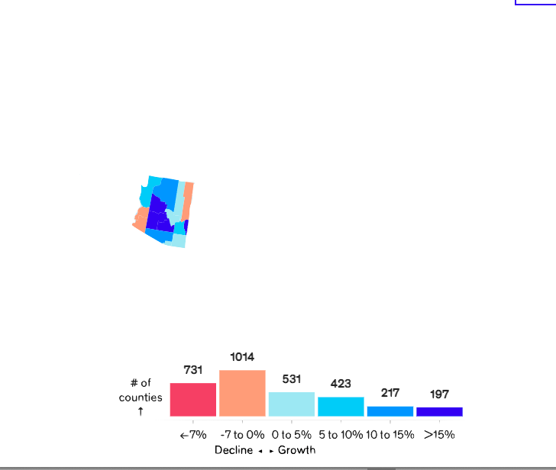
VIRTUAL EXTERNSHIPS
WHAT DO WE KNOW?
Rise of tech and automation (including AI) will impact the need for digital skills in all industries.
Nation-wide
# of counties
Source:
https://www.mckinsey.com/featured-insights/future-of-work
Arizona Pathways to Prosperity

Slide 10

VIRTUAL EXTERNSHIPS
WHAT DO WE KNOW?
IN-DEMAND
Construction
Health care and social assistance
Professional and technical services
Information Technology
Finance and insurance
Manufacturing
Transportation and warehousing
EDUCATION!
Sources:
https://www.azcommerce.com/ https://arizonaatwork.com/
Arizona Pathways to Prosperity

Slide 11


VIRTUAL EXTERNSHIPS
BREAKOUT!
  Share – Who are you, what school, what makes your heart sing
      What are your “world of work question” and externship learning goals?
  Co-create – Come up with a “Breakout motto” based on learning goals!
  Prepare – Choose someone to share out your Breakout love!
Arizona Pathways to Prosperity

Slide 12
VIRTUAL EXTERNSHIPS
CHAT SHARE OUT…
What is your “Breakout motto”?
Arizona Pathways to Prosperity

Slide 13
VIRTUAL EXTERNSHIPS
EXTERNSHIP ACTIVITIES OVERVIEW
Bringing it back to the future!
Employer sessions are rich learning opps – ASK Questions. Make Connections.
Simple + manageable daily activities (~30 min each)
Targeted at familiarization with tools and tech for…
    Employability (skill awareness, career ownership)
    Career Awareness and Exploration (applied skills, pathway options)
Shareable content and ideas
Arizona Pathways to Prosperity
Notes:
Career theory research of Linda Gottfredson: “Where do interests, abilities, and other determinants of vocational choice come from?” Research indicates that this choice is affected by various factors. Interests, attitudes, and skills are influenced by environments we share with others and, certainly, there is a relationship between identity and our environment. As we interact with our environments, our identities become more stable. As we repeat experiences, interests develop. These interests and other qualities gradually become a more stable expression of who we are.
For this reason, it is important for students to have many experiences with the world of work over their educational journey. This gives them a wide range of experiences to make better choices about their interests and the possibilities that exist for them through education and the world of work.

Slide 14

VIRTUAL EXTERNSHIPS
RESOURCES IN DRIVE…
THANK YOU!
Arizona Pathways to Prosperity

