Slide 1

Occupational Program Title
Arizona Department of Education
Appendix A
 | English (4) | Math (4) | Science (3) | History & Social Science (3) | Fine Arts & CTE (1) | Electives (7) See additional electives in chart
Grade 9 | Frosh English | Algebra I | Earth & Space Science | Elective Career Exploration | Elective Any | Elective Any *World Language University req.
Grade 10 | Soph English | Geometry | Physical Science *Chemistry Foundations | World History *Any one course | CTE | Elective Any *World Language University req.
Grade 11 | Junior English *English Comp 1 | Algebra II | Life Science *Biology Foundations | Am/AZ History *Any one course | Elective CTE
Grade 12 | Senior English *Eng Comp 1 or Eng Comp 1 and 2 | Math Choice *College Mathematics | Elective *Lab Science/Other | Government & Economics *Any one course | Elective CTE
* College credit
AZ Department of Education
Approved Industry Credentials
Helpful Websites
AZ Department of Education CTE programs
https://www.azed.gov/cte/programs
AZ Transfer
https://aztransfer.com/
AZ Transfer Exam Equivalency Guide
https://aztransmac2.asu.edu/cgi-bin/WebObjects/ATASS.woa/wa/EEG
Programs of Study: Occupational Certificates and Degrees © 2024 by Center for the Future of Arizona and Level Up Education Pathways Consulting, LLC is licensed under CC BY-NC-SA 4.0

Slide 2
Occupational Program Title
Arizona Department of Education
Appendix B
 | English (4) | Math (4) Advanced | Science (3) Advanced | History & Social Science (3) | Fine Arts & CTE (1) | Electives (7) See additional electives in chart
Grade 9 | Frosh English | Advanced Geometry | Earth & Space Science | Elective Career Exploration | Elective Any | Elective Any *World Language University req.
Grade 10 | Soph English | Advanced Algebra II *College Algebra | Physical Science | World History *Any one course | CTE | Elective Any *World Language University req.
Grade 11 | Junior English *English Comp 1 | Advanced Precalculus *Precalculus | Life Science | Am/AZ History *Any one course | Elective CTE
Grade 12 | Senior English *Eng Comp 1 or Eng Comp 1 and 2 | Math Choice *Calculus or Statistics | Elective *Chemistry or Biology for Majors | Government & Economics *Any one course | Elective CTE
* College credit
AZ Department of Education
Approved Industry Credentials
Helpful Websites
AZ Department of Education CTE programs
https://www.azed.gov/cte/programs
AZ Transfer
https://aztransfer.com/
AZ Transfer Exam Equivalency Guide
https://aztransmac2.asu.edu/cgi-bin/WebObjects/ATASS.woa/wa/EEG
Programs of Study: Occupational Certificates and Degrees © 2024 by Center for the Future of Arizona and Level Up Education Pathways Consulting, LLC is licensed under CC BY-NC-SA 4.0

Slide 3
Health Science
Appendix C
Selected Occupations, Wages, and Job Growth
Program | Typical Jobs: AZ High Demand High Wage | Average Wage | Growth in AZ; Annual Job Opening | Projected Annual Job Change | Stackable?
Pre-Professional Track | Pre-Medical Pre-Dental Other Professional Track | $134,365 $175,034 $89,760 | 174 207 323 | 0.0% 0.0% 0.0% | Typically requires bachelor’s degree and professional school
Nursing | Nursing Assistant (NA) Nursing LPN/LVN Registered Nurses Nurse Practitioner | $40,325 $57,800 $81,595 $119,913 | - 893 5,382 744 | - 0.0% 0.0% 0.1% | NA is typically required for LPN/RN RN to BSN
Dental Hygiene | Dental Assistant Dental Hygienist | $41,950 $83,296 | 1,302 408 | 0.0% 0.0% | -
Allied Health Assisting | Medical Assistant Physical Therapist Assistant Occupational Therapist Assistant | $37,793 $53,685 $59,712 | 3,525 592 226 | 0.0% 0.1% 0.1% | -
Allied Health Diagnostic | Radiologic Technologist Diagnostic Medical Sonographer | $66,600 $86,306 | 592 226 | 0.0% 0.0% | -
Allied Health Professional | Respiratory Therapist | $64,443 | 365 | 0.1% | -
Programs of Study: Occupational Certificates and Degrees © 2024 by Center for the Future of Arizona and Level Up Education Pathways Consulting, LLC is licensed under CC BY-NC-SA 4.0

Slide 4
Health Science
Nursing and Dental Hygienist • Allied Health: Assisting, Diagnostic,
and Professions Pre-Med, Pre-Dentistry, Other Professional Track
Appendix D
 | Orientation/ Introduction Grades 9-10 | Skill Development Grades 10-11 | Capstone/Advanced Grade 12 | Post Secondary Courses Recommended 1st Year
English | English Sequence | English Sequence | English Composition 1 ** English Composition 2 * | English Composition 1 English Composition 2
Math | Algebra 1 Geometry | Geometry Algebra 2 ** Precalculus ** | Algebra 2 ** Precalculus ** Calculus ** Statistics ** General Education Math * | Precalculus Calculus Statistics General Education Math
Science | Science Sequence | Biology ** | Chemistry ** | Biology for Science Majors General Chemistry Anatomy and Physiology I/II
Social Science | Social Science Sequence | Social Science Sequence | Psychology ** | Psychology
Electives | Career Exploration | Career Development Medical Terminology * | Career Development | Nursing: CNA Exam ***
 |  |  |  | If courses in this column were completed through early college credit, student should take the next required course.
Dual Enrollment Only *
AP or Dual Enrollment **
Work-based Certificate ***
Programs of Study: Occupational Certificates and Degrees © 2024 by Center for the Future of Arizona and Level Up Education Pathways Consulting, LLC is licensed under CC BY-NC-SA 4.0

Slide 5
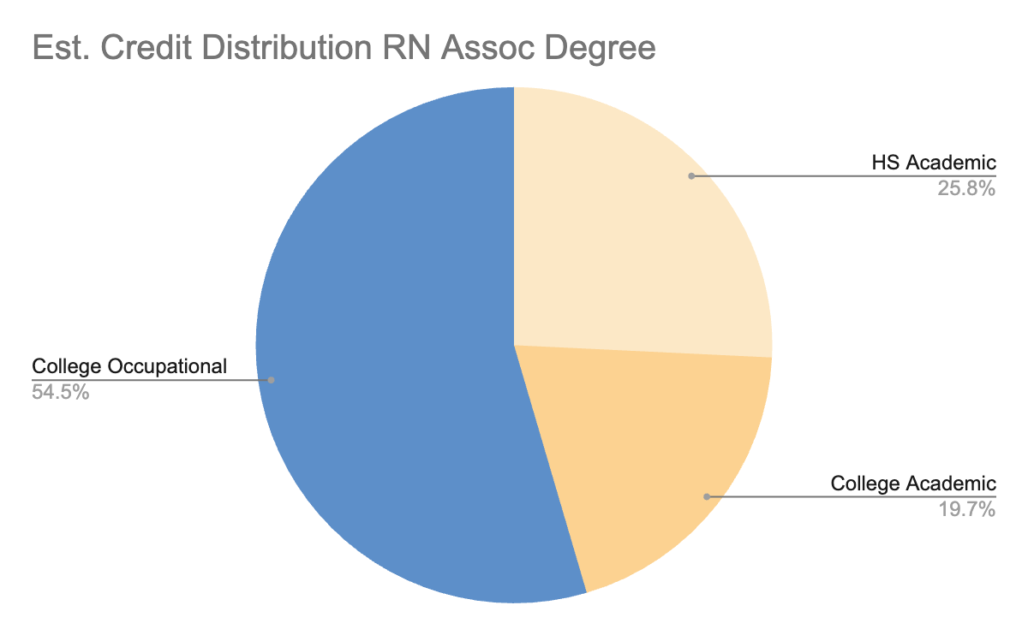
Nursing Services
Appendix E
Arizona ranks among the “top five states with the most severe healthcare staffing shortages, with the demand for specialized nurses in Arizona projected to increase by 23% by 2025” (AZBN, 2023). Since college nursing programs usually require students to satisfy prerequisites prior to program acceptance and enrollment into the nursing courses, early college strategy should focus on obtaining the Certified Nursing Assistant (CNA) credential and successfully completing prerequisite coursework that is complementary to the high school curriculum.
Making Progress Towards Completion
High School students can make informed decisions about the classes that they enroll into that are available for earned college credit. The table and chart below display useful high school class options to make progress towards an associates degree in nursing, which also applies towards a bachelor’s degree in nursing.
Questions? Contact your high school counselor or college advisor.
 | College Course | Credit Type
English | English Composition 1 and 2 (6 cr) | Dual Enrollment Concurrent Enrollment Nationally Recognized Exam
Math | College Math (3 cr) or higher | Dual Enrollment Concurrent Enrollment Nationally Recognized Exam
Science | Fundamental Chemistry (4 cr) OR General Chemistry I (4 cr) AND General Biology Majors (4 cr) | Dual Enrollment Concurrent Enrollment Nationally Recognized Exam
Elective - CTE | CNA Exam | Work-based Certificate
Programs of Study: Occupational Certificates and Degrees © 2024 by Center for the Future of Arizona and Level Up Education Pathways Consulting, LLC is licensed under CC BY-NC-SA 4.0

Slide 6
Nursing Services
Arizona Department of Education
Appendix F
 | English (4) | Math (4) | Science (3) | History & Social Science (3) | Fine Arts & CTE (1) | Electives (7) See additional electives in chart
Grade 9 | Frosh English | Algebra I | Earth & Space Science | Elective Career Exploration | Elective Any | Elective Any World Language University req.
Grade 10 | Soph English | Geometry | Physical Science *Chemistry Foundations | World History | CTE Nursing Services | Elective Any World Language University req.
Grade 11 | Junior English *English Comp 1 | Algebra II | Life Science | Am/AZ History | Elective-CTE Nursing Services
Grade 12 | Senior English *Eng Comp 1 or Eng Comp 1 and 2 | Math Choice *College Mathematics | Elective *Lab Science/Other | Government & Economics | Elective-CTE Nursing Services *CNA Exam
* College credit
AZ Department of Education
Approved Industry Credentials
Certified Nurse Assistant (CNA)
Licensed Nurse Assistant (LNA)
Helpful Websites
AZ Department of Education CTE programs
https://www.azed.gov/cte/programs
AZ Transfer
https://aztransfer.com/
AZ Transfer Exam Equivalency Guide
https://aztransmac2.asu.edu/cgi-bin/WebObjects/ATASS.woa/wa/EEG
Programs of Study: Occupational Certificates and Degrees © 2024 by Center for the Future of Arizona and Level Up Education Pathways Consulting, LLC is licensed under CC BY-NC-SA 4.0

Slide 7
Nursing Services
Arizona Department of Education
Appendix G
 | English (4) | Math (4) Advanced | Science (3) Advanced | History & Social Science (3) | Fine Arts & CTE (1) | Electives (7) See additional electives in chart
Grade 9 | Frosh English | Advanced Geometry | Earth & Space Science | Elective Career Exploration | Elective Any | Elective Any *World Language University req.
Grade 10 | Soph English | Advanced Algebra II *College Algebra | Physical Science *Chemistry Foundations | World History | CTE Nursing Services | Elective Any *World Language University req.
Grade 11 | Junior English *English Comp 1 | Advanced Precalculus *Precalculus | Life Science | Am/AZ History | Elective-CTE Nursing Services
Grade 12 | Senior English *Eng Comp 1 or Eng Comp 1 and 2 | Math Choice *Calculus or Statistics | Elective *Chemistry or Biology for Majors | Government & Economics | Elective-CTE Nursing Services *CNA Exam
* College credit
AZ Department of Education
Approved Industry Credentials
Certified Nurse Assistant (CNA)
Licensed Nurse Assistant (LNA)
Helpful Websites
AZ Department of Education CTE programs
https://www.azed.gov/cte/programs
AZ Transfer
https://aztransfer.com/
AZ Transfer Exam Equivalency Guide
https://aztransmac2.asu.edu/cgi-bin/WebObjects/ATASS.woa/wa/EEG
Programs of Study: Occupational Certificates and Degrees © 2024 by Center for the Future of Arizona and Level Up Education Pathways Consulting, LLC is licensed under CC BY-NC-SA 4.0

Slide 8
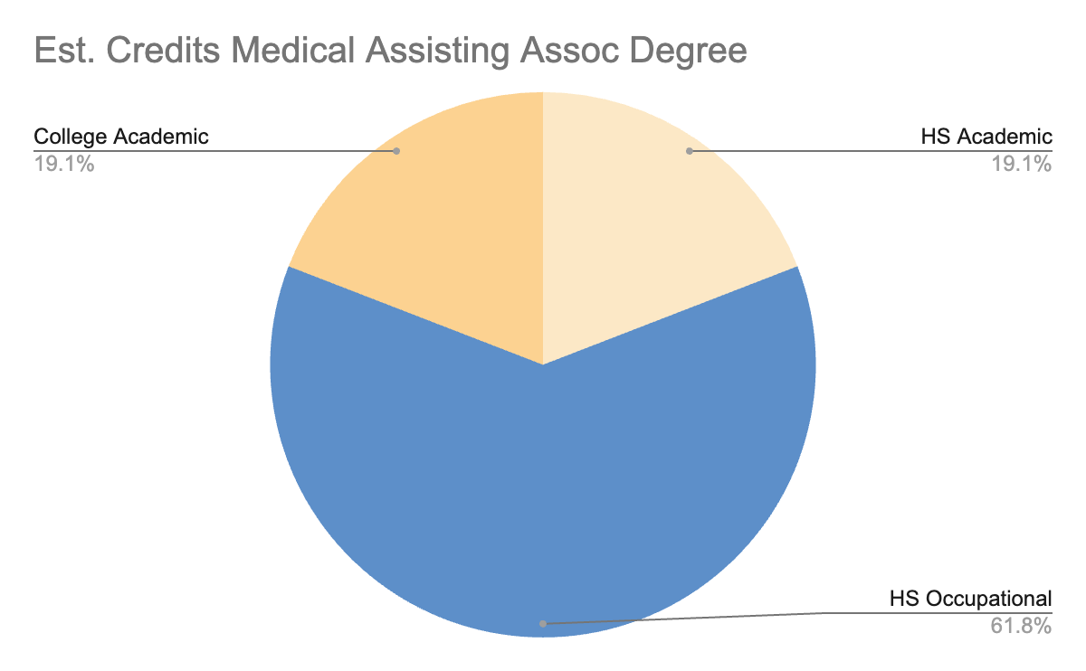
Appendix H
Medical Assisting Services
There are a wide-range of jobs that exist in the medical field and each one is important to patient care. These jobs exist in a variety of settings including hospitals, home health, therapy centers, care centers, surgical centers, and other places. Jobs in the medical field range from a full-time career to a part-time job, and Medical Assisting is a training and degree option that also provides a foundation for further study. At the high school and community college level, Medical Assisting prepares students to work alongside physicians doing things like measuring vital signs and scheduling appointments.
Making Progress Towards Completion
High School students can make informed decisions about the classes that they enroll into that are available for earned college credit. The table and chart below display useful high school class options to make progress towards an associates degree in medical assisting, which applies towards a bachelor’s degree in medical assisting or other health-related degrees.
Questions? Contact your high school counselor or college advisor.
 | College Course | Credit Type
English | English Composition 1 and 2 (6 cr) | Dual Enrollment Concurrent Enrollment Nationally Recognized Exam
Math | College Math (3 cr) or higher | Dual Enrollment Concurrent Enrollment Nationally Recognized Exam
Science | Intro to Human Anatomy and Physiology (4 cr) | Dual Enrollment Concurrent Enrollment Nationally Recognized Exam
Elective - CTE | Medical Terminology (1-3 cr) CPR, CPT, RMA, CCMA Exams (16-42 cr) | Work-based Certificate Prior Learning Assessment
Programs of Study: Occupational Certificates and Degrees © 2024 by Center for the Future of Arizona and Level Up Education Pathways Consulting, LLC is licensed under CC BY-NC-SA 4.0

Slide 9
Medical Assisting Services
Arizona Department of Education
Appendix I
 | English (4) | Math (4) | Science (3) | History & Social Science (3) | Fine Arts & CTE (1) | Electives (7) See additional electives in chart
Grade 9 | Frosh English | Algebra I | Earth & Space Science | Elective Career Exploration | Elective Any | Elective Any *World Language University req.
Grade 10 | Soph English | Geometry | Physical Science | World History | CTE Medical Assist Services CPR Exam | Elective Any *World Language University req.
Grade 11 | Junior English *English Comp 1 | Algebra II | Life Science | Am/AZ History | Elective-CTE Medical Assisting Services HCCxxx: Medical Terminology
Grade 12 | Senior English *Eng Comp 1 or Eng Comp 1 and 2 | Math Choice *College Mathematics | Elective *Intro to Human Anatomy and Physiology | Government & Economics | Elective-CTE Medical Assisting Services *CPT Exam *RMA Exam *CCMA Exam
* College credit
AZ Department of Education
Approved Industry Credentials
Certified Phlebotomy Technician (CPT)
Registered Medical Assistant (RMA)
Clinical Medical Assistant (CCMA)
Helpful Websites
AZ Department of Education CTE programs
https://www.azed.gov/cte/programs
AZ Transfer
https://aztransfer.com/
AZ Transfer Exam Equivalency Guide
https://aztransmac2.asu.edu/cgi-bin/WebObjects/ATASS.woa/wa/EEG
Programs of Study: Occupational Certificates and Degrees © 2024 by Center for the Future of Arizona and Level Up Education Pathways Consulting, LLC is licensed under CC BY-NC-SA 4.0

Slide 10
Appendix J
Information Technology
Selected Occupations, Wages, and Job Growth
Program | Typical Jobs: AZ High Demand High Wage | Average Wage | Growth in AZ; Annual Job Opening | Projected Annual Job Change | Stackable?
Network | Computer Network Architects Computer Network Support Network and Computer Systems | $118,807 $62,541 $87,906 | 399 436 736 | 0.0% 0.0% 0.0% | Industry certificates to associate’s degrees to bachelor’s degrees
Cybersecurity | Information Security Analyst | $108,643 | 584 | 0.1% | Industry certificates to associate’s degrees to bachelor’s degrees
Hardware Engineers | Computer Hardware Engineers | $121,905 | 255 | 0.01% | Industry certificates to associate’s degrees to bachelor’s degrees
Other | Computer Occupations, Other | $84,029 | 7,087 | 0.0% | Not enough information
Programs of Study: Occupational Certificates and Degrees © 2024 by Center for the Future of Arizona and Level Up Education Pathways Consulting, LLC is licensed under CC BY-NC-SA 4.0

Slide 11
Information Technology
Network and Computer Systems, Cybersecurity,
Hardware Engineers and Other Computing Professions
Appendix K
 | Orientation/ Introduction Grades 9-10 | Skill Development Grades 10-11 | Capstone/Advanced Grade 12 | Post Secondary Courses Recommended 1st Year
English | English Sequence | English Sequence | English Composition 1 ** English Composition 2 * | English Composition 1 English Composition 2
Math | Algebra 1 Geometry | Geometry Algebra 2 ** Precalculus ** | Algebra 2 ** Precalculus ** Calculus ** Statistics ** General Education Math * | General Education Math
Science | Science Sequence | Biology ** | Chemistry ** | Fundamental Chemistry OR Introduction to Biology OR Other Lab Science
Social Science | World History ** | U.S. History ** | U.S. Government ** Economics ** | See program requirements
Electives | Career Exploration | Career Development | Career Development | See program requirements
 |  |  |  | If courses in this column were completed through early college credit, student should take the next required course.
Dual Enrollment Only *
AP or Dual Enrollment **
Work-based Certificate ***
Programs of Study: Occupational Certificates and Degrees © 2024 by Center for the Future of Arizona and Level Up Education Pathways Consulting, LLC is licensed under CC BY-NC-SA 4.0

Slide 12
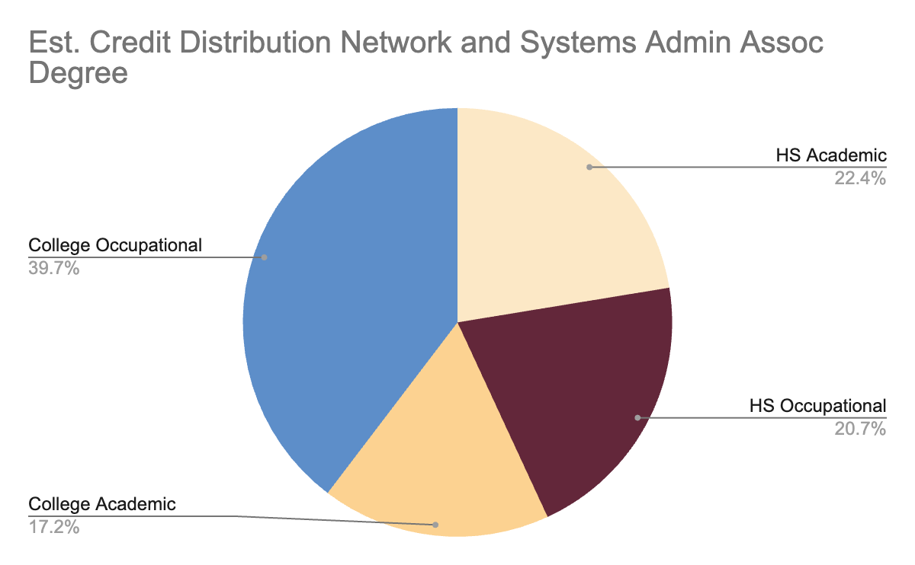
Technology Device Maintenance
Appendix L
Technology device maintenance prepares students to design, development, installation, implementation, use, and management of computers and various computer devices. Students who successfully complete the Technology Devices Maintenance program’s coherent sequence of instruction will develop effective methods to troubleshooting problems using effective communication skills by asking key questions, listening for technical problems and, in turn, explaining problems in an understandable way.
Making Progress Towards Completion
High School students can make informed decisions about the classes that they enroll into that are available for earned college credit. The table and chart below display useful high school class options to make progress towards an associates degree in network and systems administration, which applies towards a bachelor’s degree in computer science or a related degree.
Questions? Contact your high school counselor or college advisor.
 | College Course | Credit Type
English | English Composition 1 and 2 (6 cr) | Dual Enrollment Concurrent Enrollment Nationally Recognized Exam
Math | College Math (3 cr) or higher | Dual Enrollment Concurrent Enrollment Nationally Recognized Exam
Science | Any lab science (4 cr) | Dual Enrollment Concurrent Enrollment Nationally Recognized Exam
Elective - CTE | Survey of Computer Info (3 cr) CompTIA Exams (6-9 cr) | Work-based Certificate Prior Learning Assessment
Programs of Study: Occupational Certificates and Degrees © 2024 by Center for the Future of Arizona and Level Up Education Pathways Consulting, LLC is licensed under CC BY-NC-SA 4.0

Slide 13
Appendix M
Technology Device Maintenance
Arizona Department of Education
 | English (4) | Math (4) | Science (3) | History & Social Science (3) | Fine Arts & CTE (1) | Electives (7) See additional electives in chart
Grade 9 | Frosh English | Algebra I | Earth & Space Science | Elective Career Exploration | Elective Any | Elective Any *World Language University req.
Grade 10 | Soph English | Geometry | Physical Science *Chemistry Foundations | World History | CTE Technology Device Maintenance *Survey of Computer Information Systems | Elective Any *World Language University req.
Grade 11 | Junior English *English Comp 1 | Algebra II | Life Science *Biology Foundations | Am/AZ History | Elective-CTE Technology Device Maintenance
Grade 12 | Senior English *Eng Comp 1 or Eng Comp 1 and 2 | Math Choice *College Mathematics | Elective | Government & Economics | Elective-CTE Technology Device Maintenance *See all industry credentials listed below
* College credit
AZ Department of Education
Approved Industry Credentials
CompTIA A+
CompTIA IT Fundamentals
CompTIA Network+
CompTIA Security+
Microsoft Office Specialist (MOS)
See full list of ADE approved industry credentials
Helpful Websites
AZ Department of Education CTE programs
https://www.azed.gov/cte/programs
AZ Transfer
https://aztransfer.com/
AZ Transfer Exam Equivalency Guide
https://aztransmac2.asu.edu/cgi-bin/WebObjects/ATASS.woa/wa/EEG
Programs of Study: Occupational Certificates and Degrees © 2024 by Center for the Future of Arizona and Level Up Education Pathways Consulting, LLC is licensed under CC BY-NC-SA 4.0

Slide 14
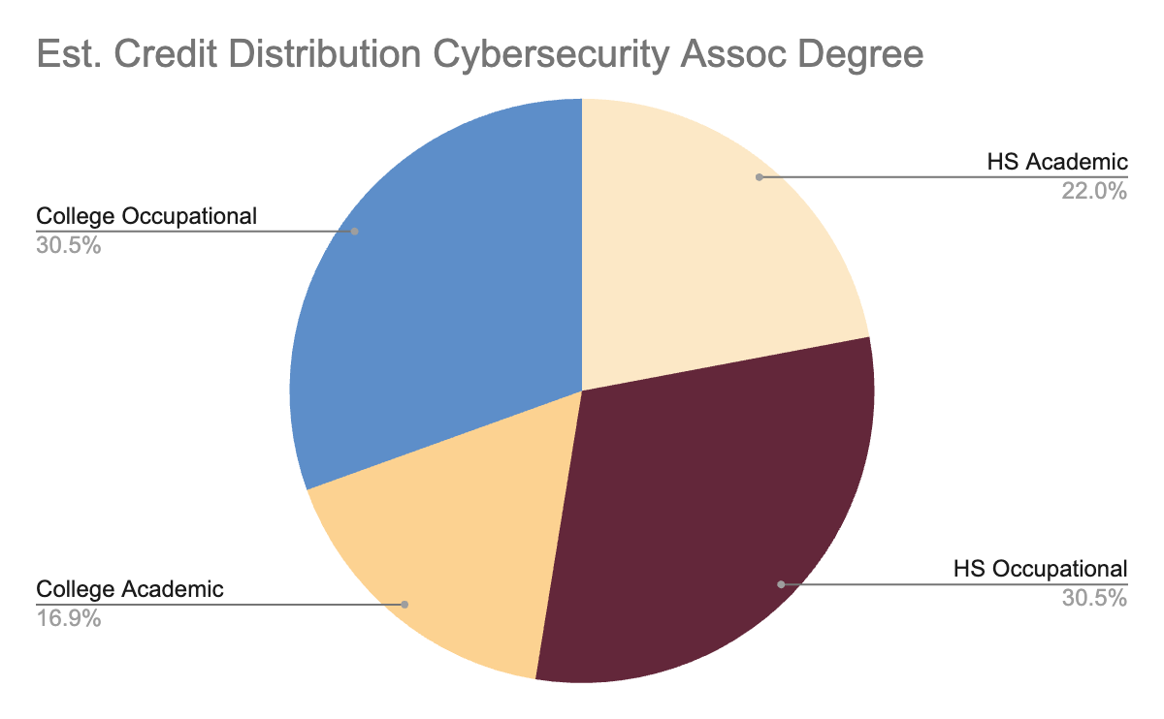
Network Security
Appendix N
The Network Security program prepares students to assess the security needs of computer and network systems, recommend safeguard solutions, and manage the implementation and maintenance of security devices, systems, and procedures. Students who successfully complete the Network Security program’s coherent sequence of instruction will develop skill to analyze, test, troubleshoot, and evaluate existing network systems. Also, students perform network maintenance to ensure networks operate correctly with minimal interruption.
Making Progress Towards Completion
High School students can make informed decisions about the classes that they enroll into that are available for earned college credit. The table and chart below display useful high school class options to make progress towards an associates degree in cybersecurity, which applies towards a bachelor’s degree in cybersecurity or a related degree.
Questions? Contact your high school counselor or college advisor.
 | College Course | Credit Type
English | English Composition 1 and 2 (6 cr) | Dual Enrollment Concurrent Enrollment Nationally Recognized Exam
Math | College Math (3 cr) or higher | Dual Enrollment Concurrent Enrollment Nationally Recognized Exam
Science | Any lab science (4 cr) | Dual Enrollment Concurrent Enrollment Nationally Recognized Exam
Elective - CTE | Survey of Computer Info (3 cr) CompTIA Security+ (3 cr) CCNA Exam (12 cr) | Work-based Certificate Prior Learning Assessment
Programs of Study: Occupational Certificates and Degrees © 2024 by Center for the Future of Arizona and Level Up Education Pathways Consulting, LLC is licensed under CC BY-NC-SA 4.0

Slide 15
Network Security
Arizona Department of Education
Appendix O
 | English (4) | Math (4) | Science (3) | History & Social Science (3) | Fine Arts & CTE (1) | Electives (7) See additional electives in chart
Grade 9 | Frosh English | Algebra I | Earth & Space Science | Elective Career Exploration | Elective Any | Elective Any *World Language University req.
Grade 10 | Soph English | Geometry | Physical Science *Chemistry Foundations | World History | CTE Network Security *Survey of Computer Information Systems | Elective Any *World Language University req.
Grade 11 | Junior English *English Comp 1 | Algebra II | Life Science *Biology Foundations | Am/AZ History | Elective-CTE Network Security
Grade 12 | Senior English *Eng Comp 1 or Eng Comp 1 and 2 | Math Choice *College Mathematics | Elective | Government & Economics | Elective-CTE Network Security *CompTIA Security+ *CCNA Exam
* College credit
AZ Department of Education
Approved Industry Credentials
Certified Network Associate (CCNA)
See full list of ADE approved industry credentials
Helpful Websites
AZ Department of Education CTE programs
https://www.azed.gov/cte/programs
AZ Transfer
https://aztransfer.com/
AZ Transfer Exam Equivalency Guide
https://aztransmac2.asu.edu/cgi-bin/WebObjects/ATASS.woa/wa/EEG
Programs of Study: Occupational Certificates and Degrees © 2024 by Center for the Future of Arizona and Level Up Education Pathways Consulting, LLC is licensed under CC BY-NC-SA 4.0

Slide 16
Appendix P
Advanced Manufacturing
Selected Occupations, Wages, and Job Growth
Program | Typical Jobs: AZ High Demand High Wage | Average Wage | Growth in AZ; Annual Job Opening | Projected Annual Job Change | Stackable?
Industrial Engineering Technician | Industrial Engineering Technician | $68,178 | 199 | 0.0% | Industry credentials to associate’s degree
Mechanical Engineering Technician | Mechanical Engineering Technician | $61,973 | 133 | 0.0% | Industry credentials to associate’s degree
Automated Industrial Technology | Electro-Mechanical Technicians Robotics Technician | $75,061 $75,061 | - - | - - | Industry credentials to associate’s degree
Engineer | Aerospace Computer Hardware Electrical Industrial Mechanical | $140,429 $121,905 $99,832 $100,802 $100,007 | 209 255 614 793 575 | 0.0% 0.1% 0.0% 0.1% 0.0% | Industry credentials to associate’s degree to bachelor’s degree
Programs of Study: Occupational Certificates and Degrees © 2024 by Center for the Future of Arizona and Level Up Education Pathways Consulting, LLC is licensed under CC BY-NC-SA 4.0

Slide 17
Advanced Manufacturing
Industrial Engineering Technician, Mechanical Engineering
Technician, Automated Industrial Technologist, Engineer
Appendix Q
 | Orientation/ Introduction Grades 9-10 | Skill Development Grades 10-11 | Capstone/Advanced Grade 12 | Post Secondary Courses Recommended 1st Year
English | English Sequence | English Sequence | English Composition 1 ** English Composition 2 * | English Composition 1 English Composition 2
Math | Algebra 1 Geometry | Geometry Algebra 2 ** Precalculus ** | Algebra 2 ** Precalculus ** Calculus ** Statistics ** General Education Math * | Precalculus Calculus Statistics General Education Math
Science | Science Sequence | Biology ** | Chemistry ** | General Chemistry Physics for Majors
Social Science | World History ** | U.S. History ** | U.S. Government ** Economics ** | See program requirements
Electives | Career Exploration | Career Development | Career Development | See program requirements
 |  |  |  | If courses in this column were completed through early college credit, student should take the next required course.
Dual Enrollment Only *
AP or Dual Enrollment **
Work-based Certificate ***
Programs of Study: Occupational Certificates and Degrees © 2024 by Center for the Future of Arizona and Level Up Education Pathways Consulting, LLC is licensed under CC BY-NC-SA 4.0

Slide 18
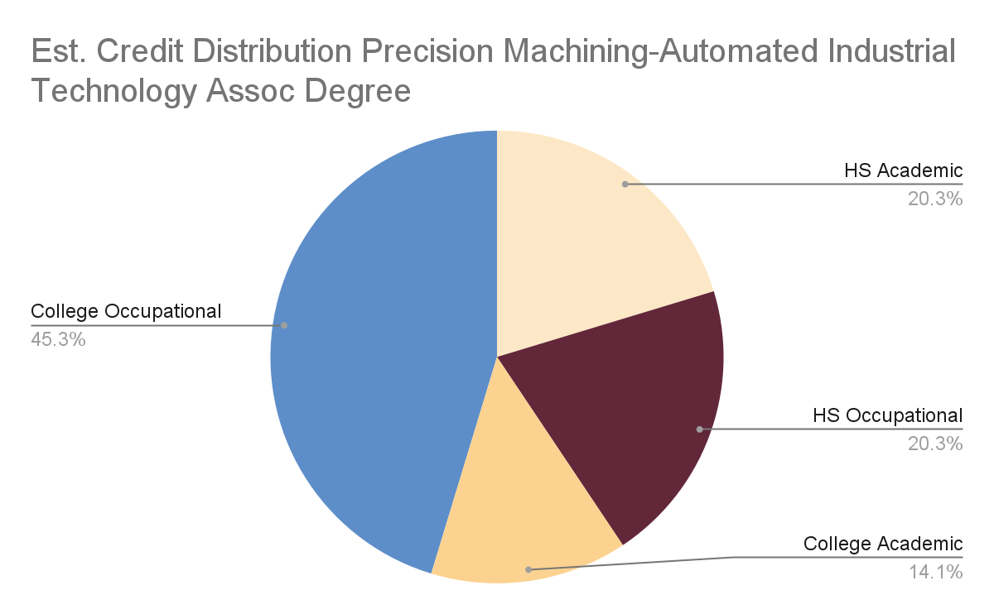
Advanced Manufacturing
Appendix R
Precision machining and engineering are programs that complement manufacturing and automated industrial technology skill sets. Typical jobs in these fields range from electrical, mechanical, and robotics technicians to specialized engineers. Industry exposure it important to career development, and stackable industry and college credentials can prepare students for this dynamic and high demand workforce.
Making Progress Towards Completion
High School students can make informed decisions about the classes that they enroll into that are available for earned college credit. The table and chart below display useful high school class options to make progress towards an associates degree in advanced manufacturing, automated industrial technology, or engineering, which applies towards a bachelor’s degree in a related degree.
Questions? Contact your high school counselor or college advisor.
 | College Course | Credit Type
English | English Composition 1 and 2 (6 cr) | Dual Enrollment Concurrent Enrollment Nationally Recognized Exam
Math | College Math (3 cr) or higher | Dual Enrollment Concurrent Enrollment Nationally Recognized Exam
Science | Any lab science (4 cr) *Chemistry recommended | Dual Enrollment Concurrent Enrollment Nationally Recognized Exam
Elective - CTE | Manufacturing, Automated Technology, or Engineering | Work-based Certificate Prior Learning Assessment
Programs of Study: Occupational Certificates and Degrees © 2024 by Center for the Future of Arizona and Level Up Education Pathways Consulting, LLC is licensed under CC BY-NC-SA 4.0

Slide 19
Appendix S
Precision Machining & Engineering
Arizona Department of Education
 | English (4) | Math (4) | Science (3) | History & Social Science (3) | Fine Arts & CTE (1) | Electives (7) See additional electives in chart
Grade 9 | Frosh English | Algebra I | Earth & Space Science | Elective Career Exploration | Elective Any | Elective Any *World Language University req.
Grade 10 | Soph English | Geometry | Physical Science *Chemistry Foundations | World History | CTE Precision Machining OR Engineering | Elective Any *World Language University req.
Grade 11 | Junior English *English Comp 1 | Algebra II | Life Science | Am/AZ History | Elective-CTE Precision Machining OR Engineering
Grade 12 | Senior English *Eng Comp 1 or Eng Comp 1 and 2 | Math Choice *College Mathematics | Elective | Government & Economics | Elective-CTE Precision Machining OR Engineering
* College credit
AZ Department of Education
Approved Industry Credentials
Autodesk Certified User
Solidworks
See full list of ADE approved industry credentials
Helpful Websites
AZ Department of Education CTE programs
https://www.azed.gov/cte/programs
AZ Transfer
https://aztransfer.com/
AZ Transfer Exam Equivalency Guide
https://aztransmac2.asu.edu/cgi-bin/WebObjects/ATASS.woa/wa/EEG
Programs of Study: Occupational Certificates and Degrees © 2024 by Center for the Future of Arizona and Level Up Education Pathways Consulting, LLC is licensed under CC BY-NC-SA 4.0

Slide 20
Appendix T
Engineering
Arizona Department of Education
 | English (4) | Math (4) Advanced | Science (3) Advanced | History & Social Science (3) | Fine Arts & CTE (1) | Electives (7) See additional electives in chart
Grade 9 | Frosh English | Advanced Geometry | Earth & Space Science | Elective Career Exploration | Elective Any | Elective Any *World Language University req.
Grade 10 | Soph English | Advanced Algebra II *College Algebra | Physical Science | World History | CTE Engineering | Elective Any *World Language University req.
Grade 11 | Junior English *English Comp 1 | Advanced Precalculus *Precalculus | Life Science | Am/AZ History | Elective CTE Engineering
Grade 12 | Senior English *Eng Comp 1 or Eng Comp 1 and 2 | Math Choice *Calculus or Statistics | Elective *Chemistry for Majors | Government & Economics | Elective CTE Engineering
* College credit
AZ Department of Education
Approved Industry Credentials
Autodesk Certified User
Solidworks
See full list of ADE approved industry credentials
Helpful Websites
AZ Department of Education CTE programs
https://www.azed.gov/cte/programs
AZ Transfer
https://aztransfer.com/
AZ Transfer Exam Equivalency Guide
https://aztransmac2.asu.edu/cgi-bin/WebObjects/ATASS.woa/wa/EEG
Programs of Study: Occupational Certificates and Degrees © 2024 by Center for the Future of Arizona and Level Up Education Pathways Consulting, LLC is licensed under CC BY-NC-SA 4.0

Slide 21
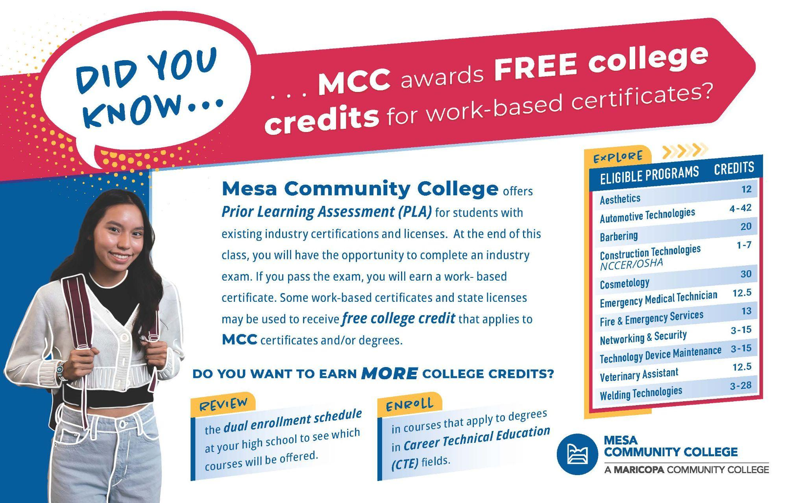
Appendix U

Slide 22
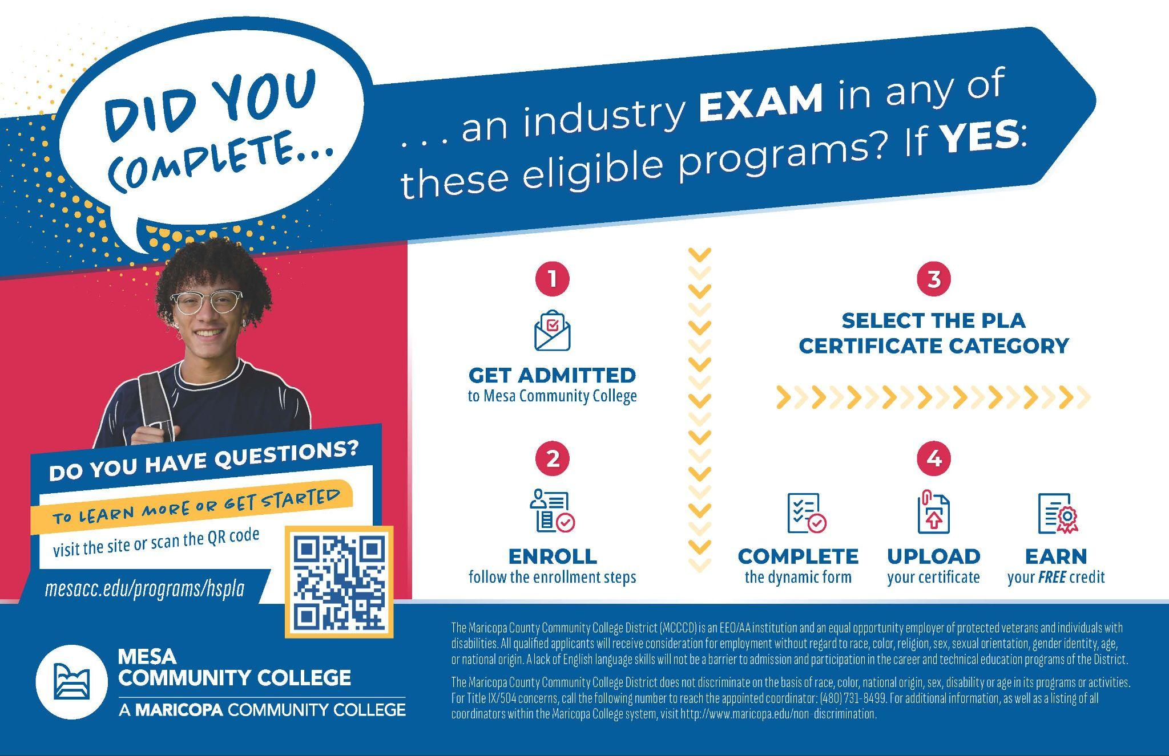
Appendix V

